Slide 1
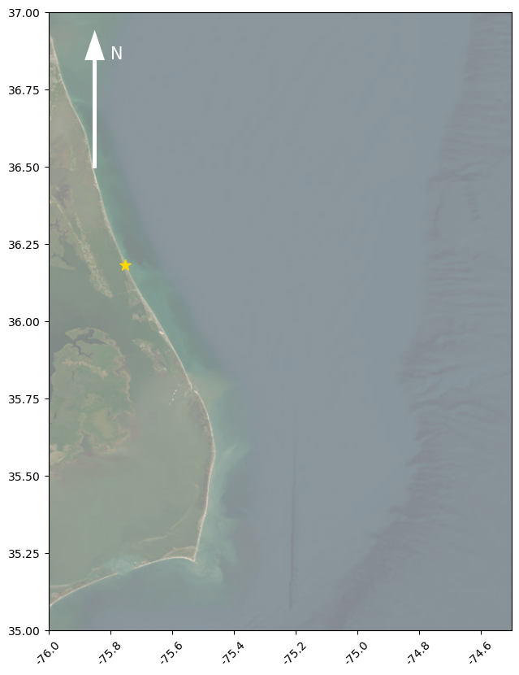
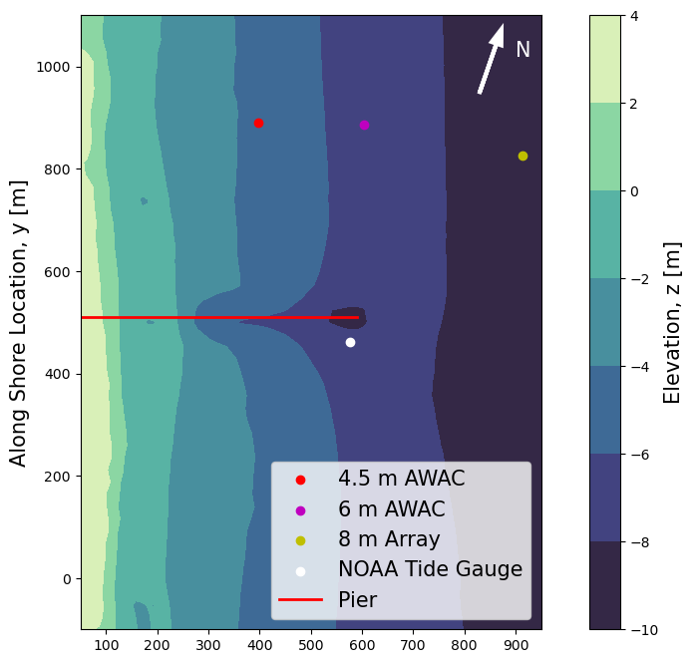
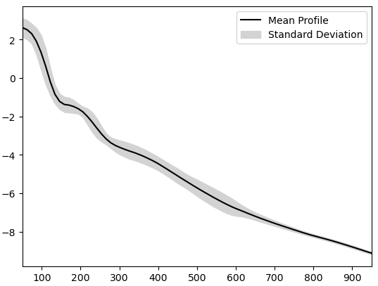
Figure 1 – Location of Field site, fixed instruments and bathymetry
(a)
(b)
Along Shore Location, y [m]
Elevation, z [m]
Latitude [°N]
Cross Shore Location, x [m]
Elevation, z [m]
(c)
Cross Shore Location, x [m]
Longitude [°E]

Slide 2
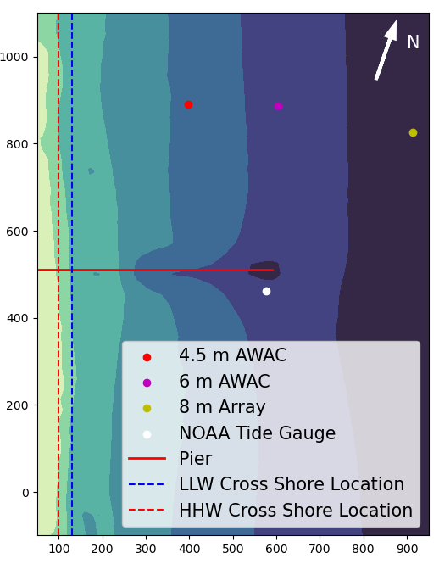
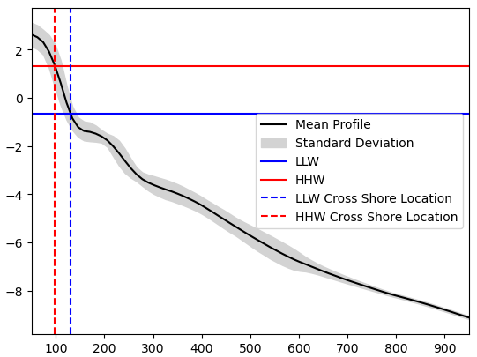
Figure 1 edited – Location of Field site, fixed instruments and bathymetry
(a)
(b)
Elevation, z [m]
Along Shore Location, y [m]
Latitude [°N]
Cross Shore Location, x [m]
(c)
Elevation, z [m]
Cross Shore Location, x [m]
Longitude [°E]

Slide 3
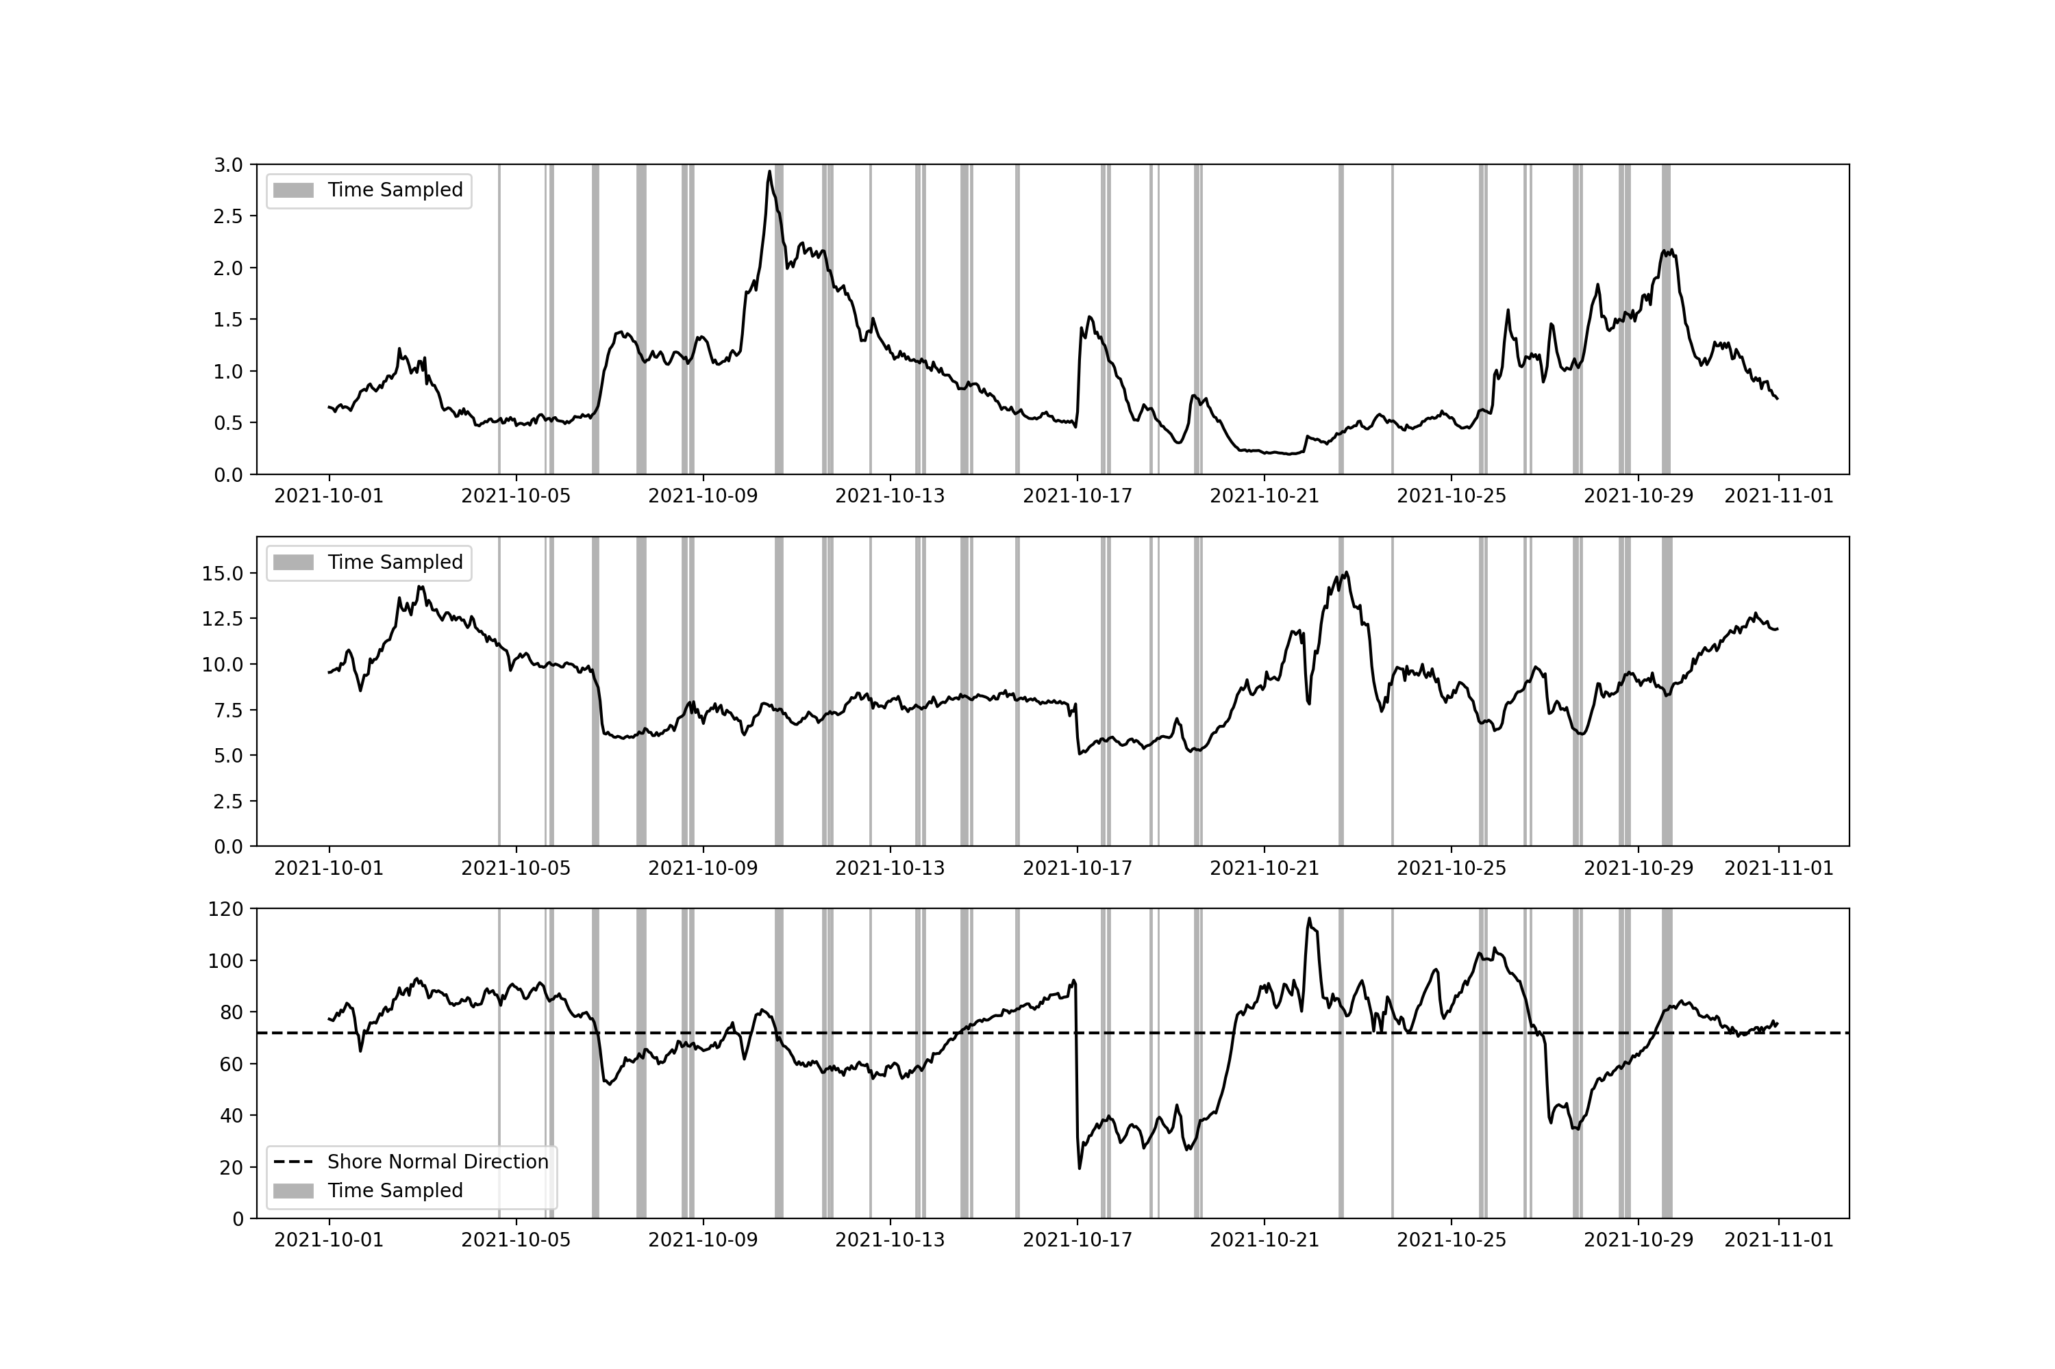
Figure 2 – Conditions sampled during the experiment
(a)
Significant Wave Height [m]
(b)
Mean Wave Period [s]
(c)
Mean Wave Direction [deg from north]
Time [UTC]

Slide 4
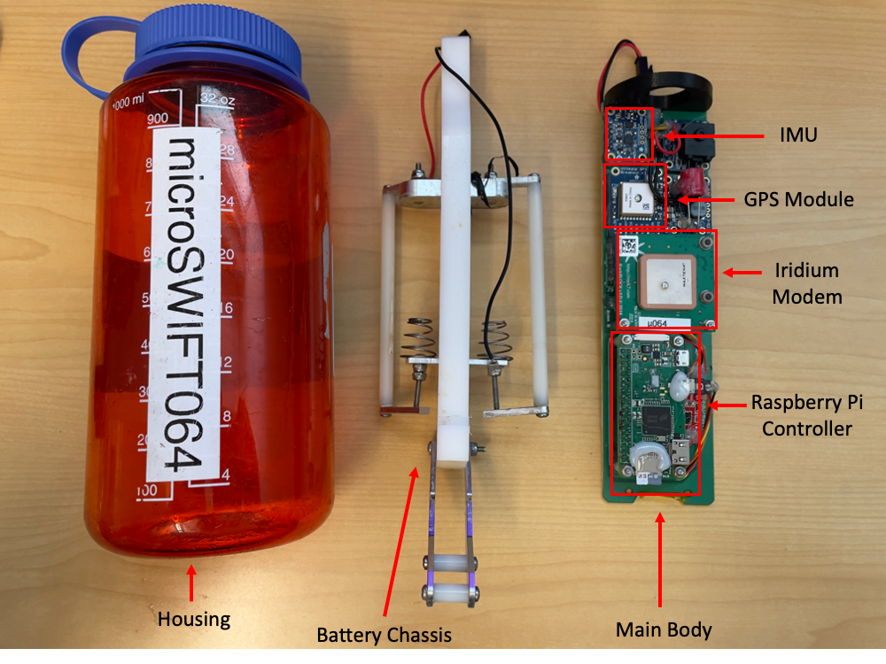
Figure 3 – Layout of microSWIFT

Slide 5
Figure 4 – Recording Software Flow
Main Processing and Control Script
(microSWIFT.py)
Boot up and Start Onboard Logging
Wait for Start of Recording Window
Record IMU Data
Record GPS Data
Onboard Processing of Data
(GPSwaves Algorithm)
Send Processed Data to Server
Notes:
Arrows branching from record IMU data and record GPS data make it look like “either or” instead of “and”. At the end bracket from “send processed data to server”, add arrows on each line connecting it back to “wait for start of recording window”

Slide 6
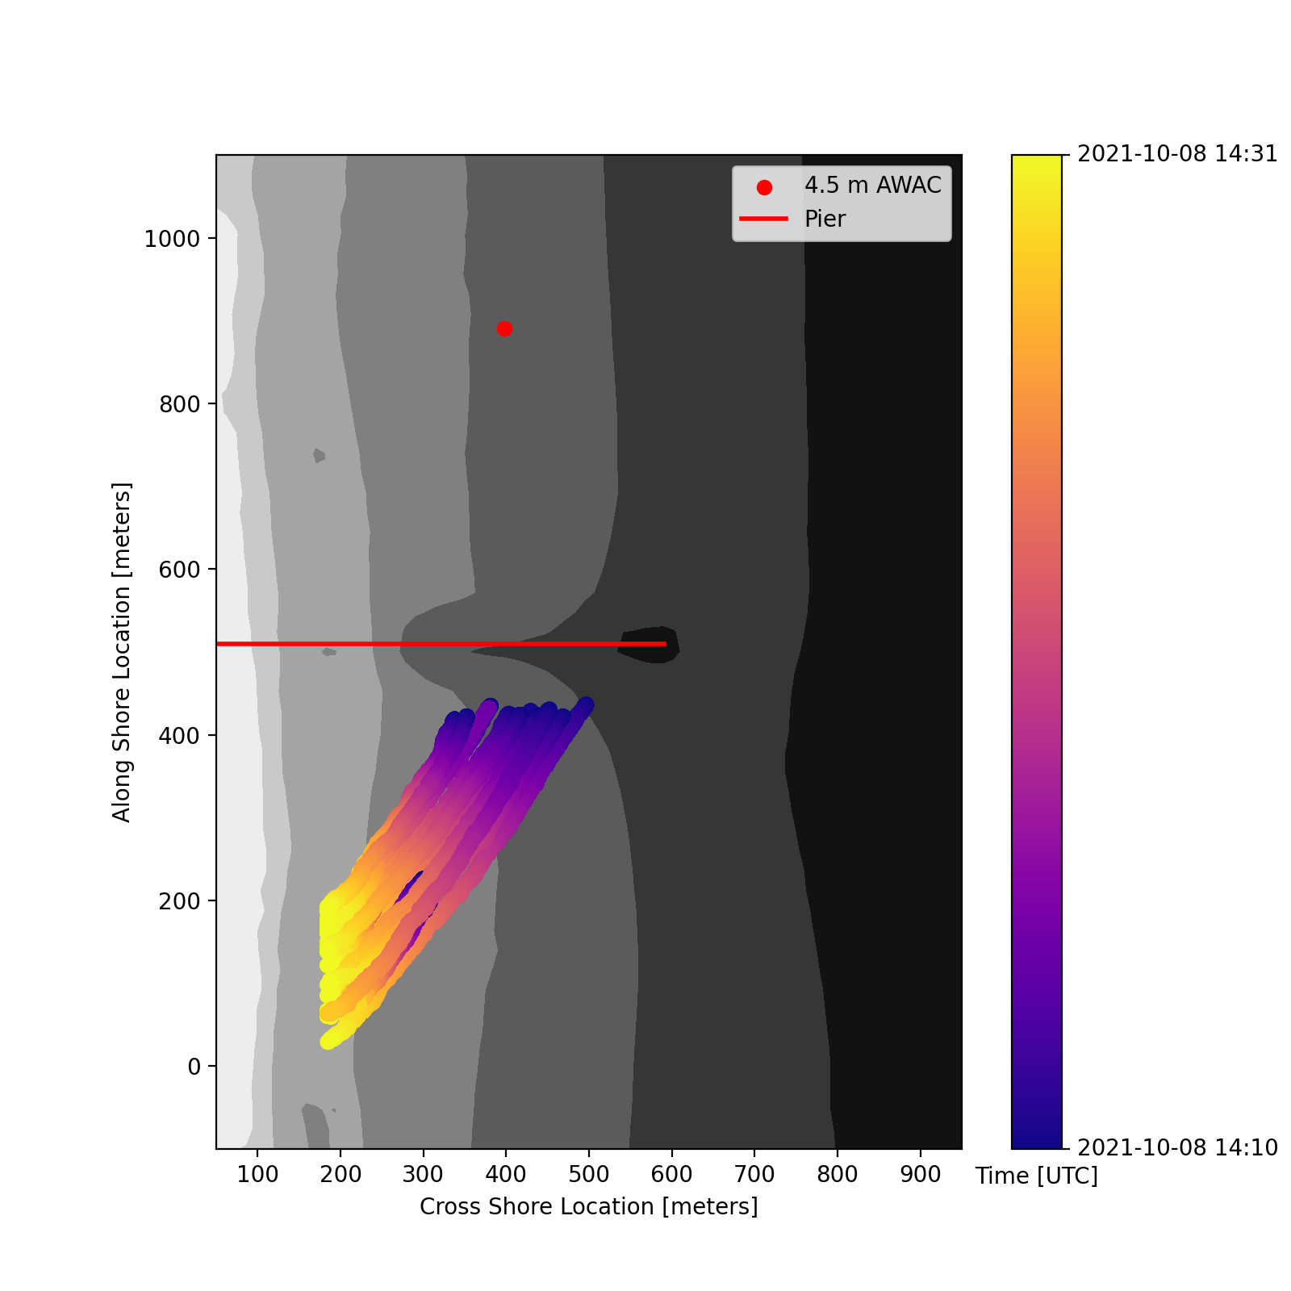
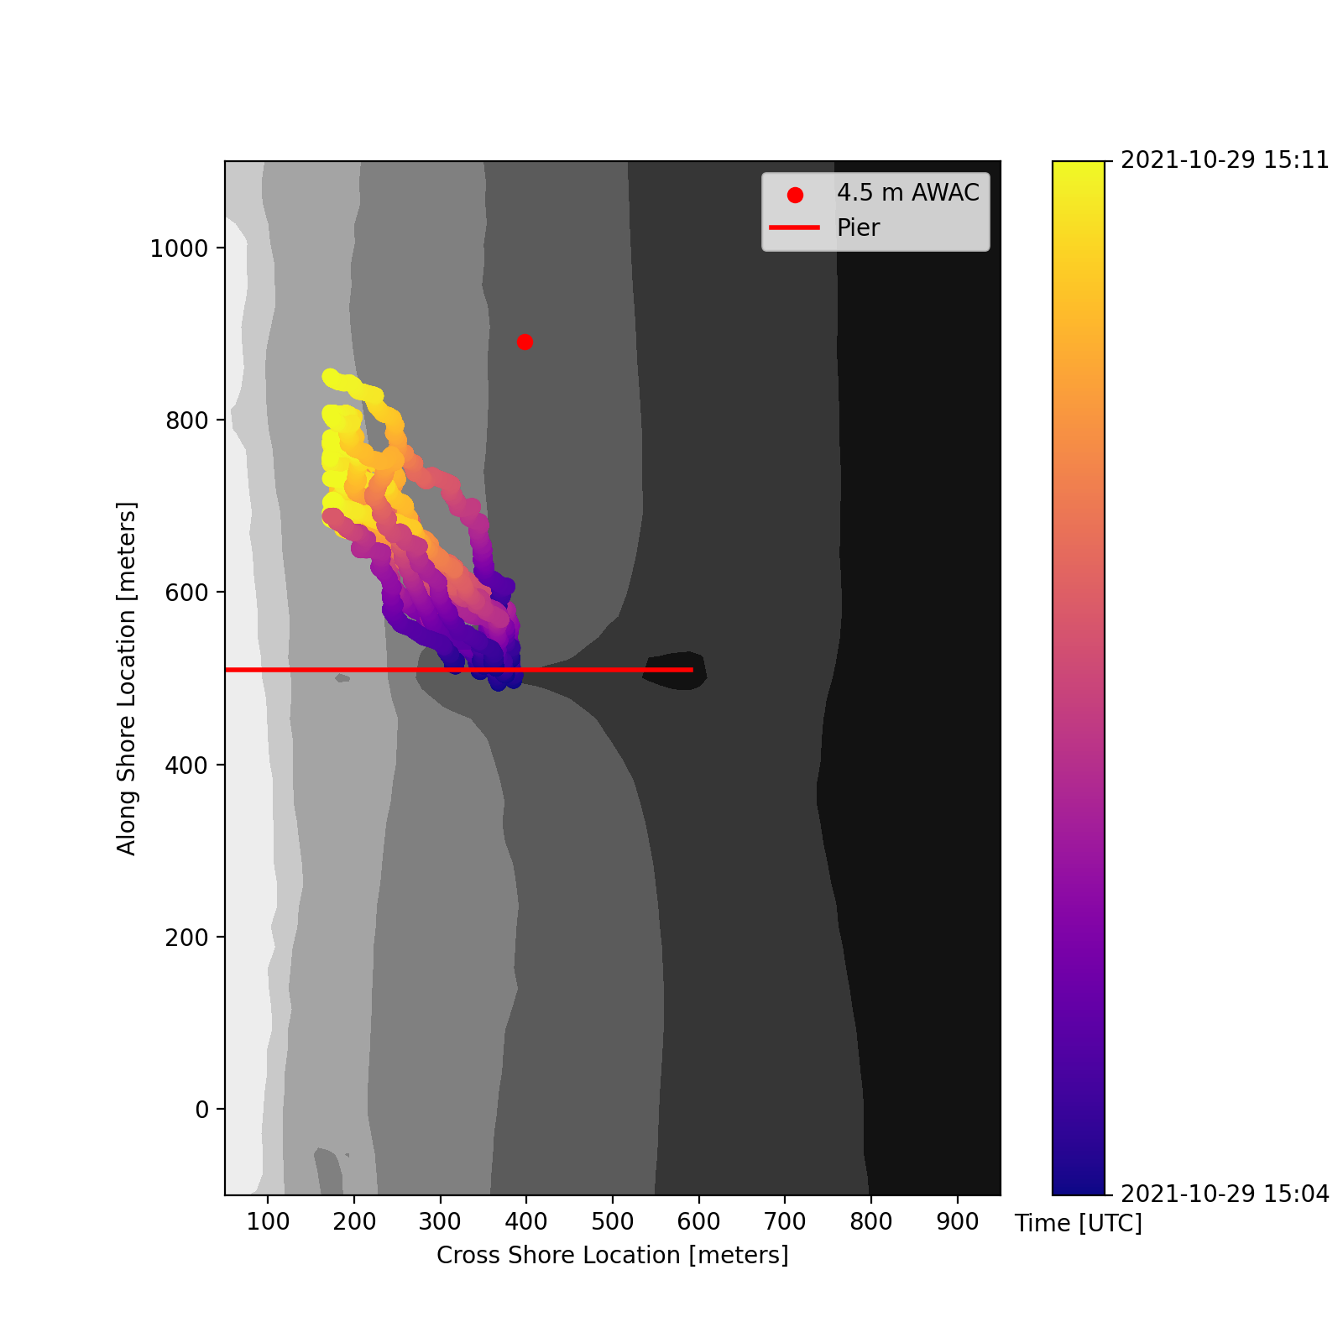
Figure 5 – Example Missions
Time [UTC]
2021-10-29 15:04
Time [UTC]
2021-10-08 14:10
2021-10-08 14:31
2021-10-29 15:11
(a)
(b)
-4 meters
-6 meters
-8 meters
-4 meters
-6 meters
-8 meters
Along Shore Location, y [m]
Along Shore Location, y [m]
Cross Shore Location, x [m]
Cross Shore Location, x [m]
Notes:
Increase size of label for color bar and make units more clear

Slide 7
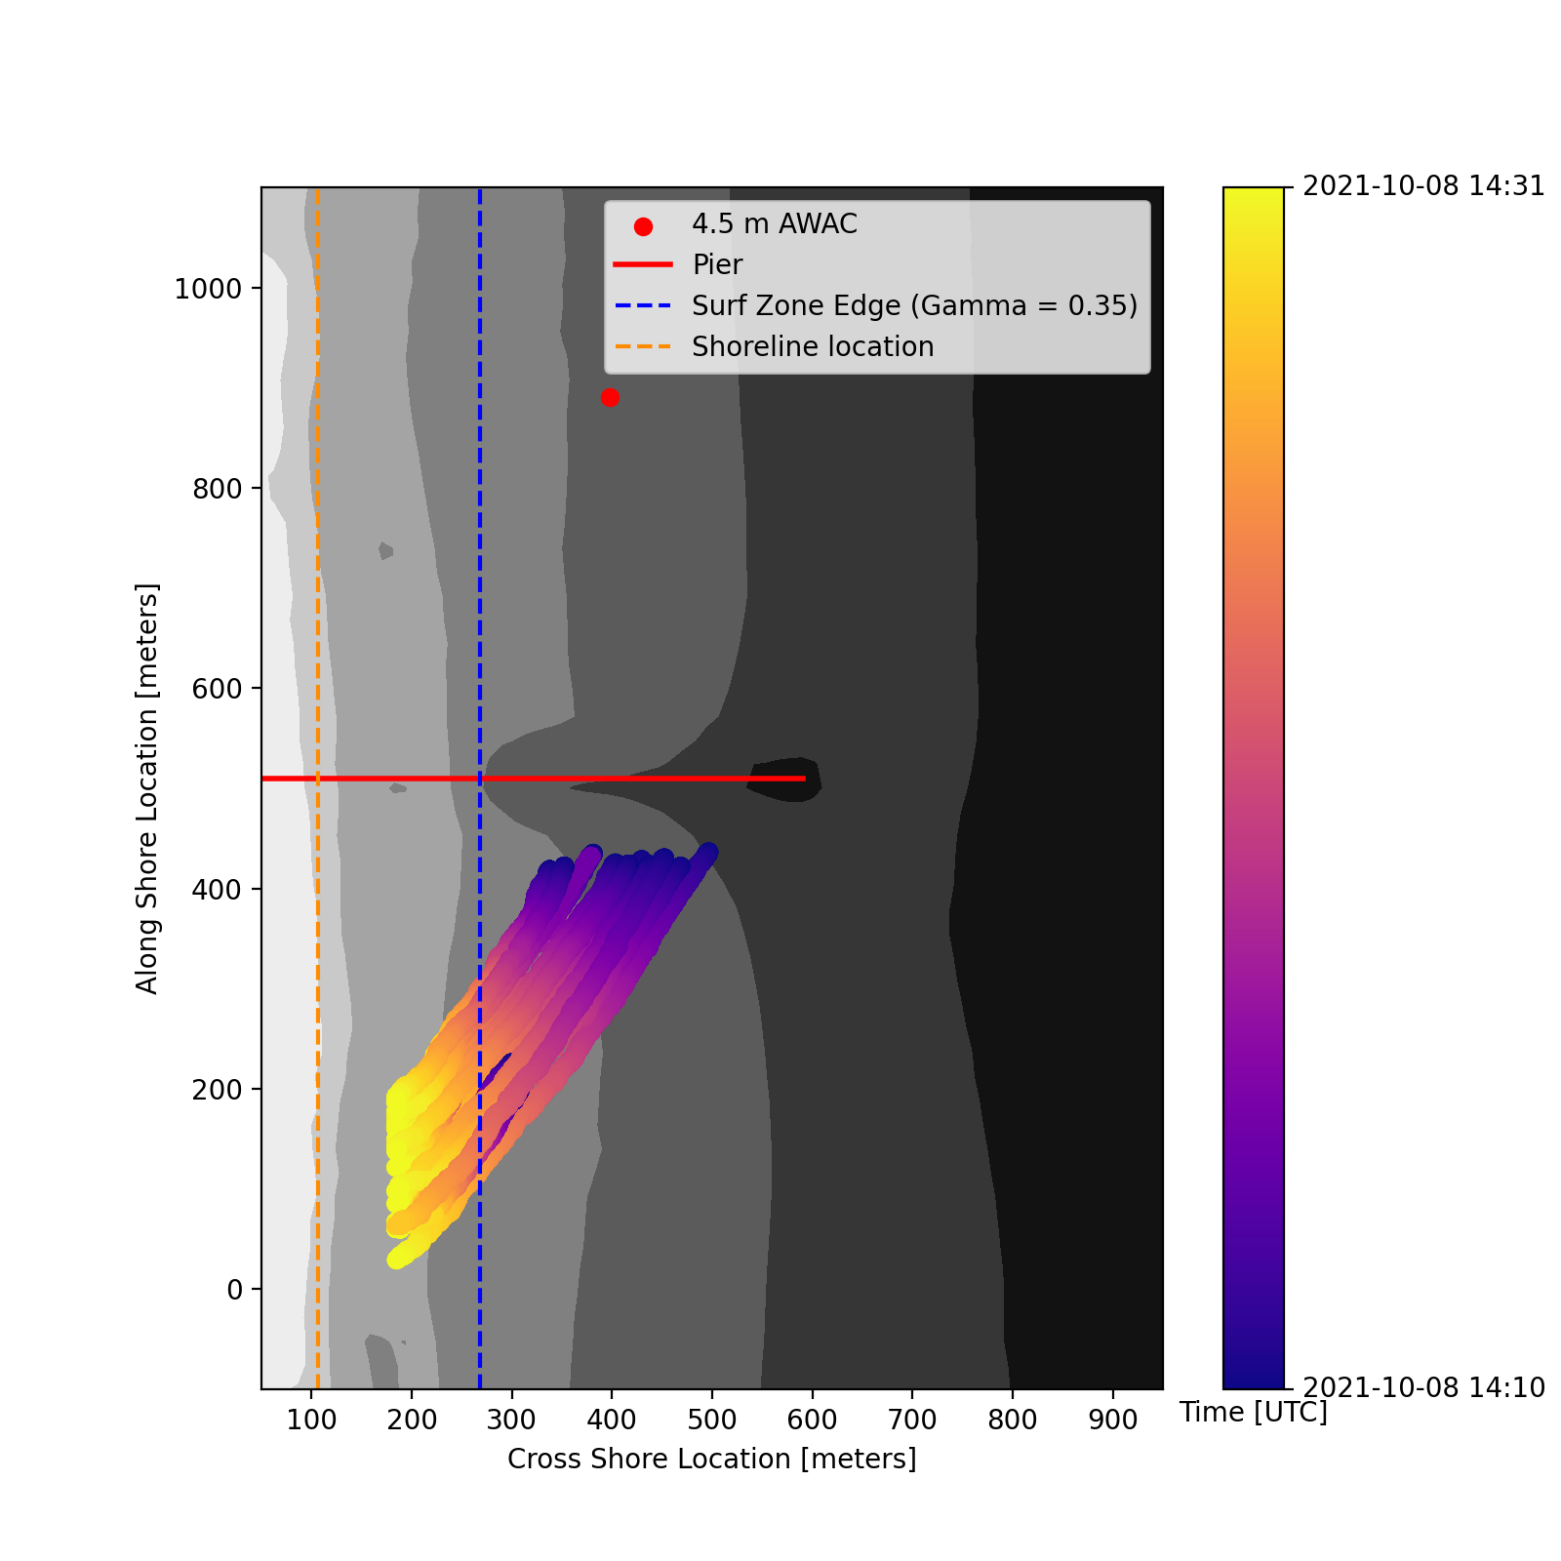
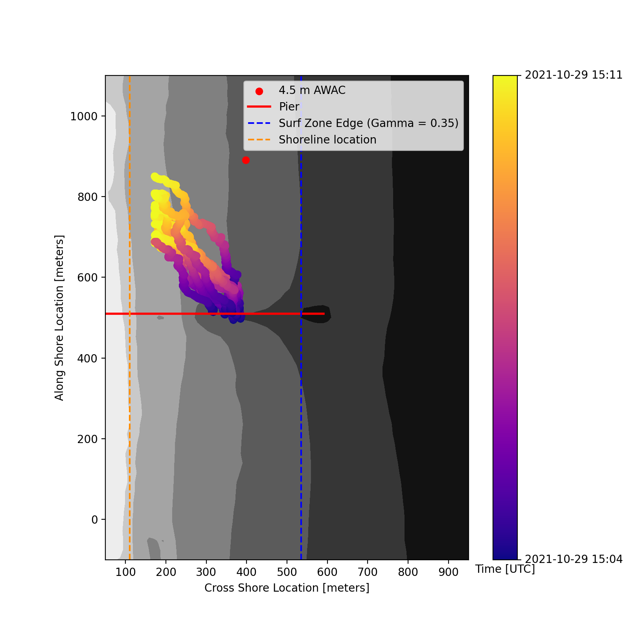
Figure 5 edited – Example Missions
Time [UTC]
2021-10-29 15:04
Time [UTC]
2021-10-08 14:10
2021-10-08 14:31
2021-10-29 15:11
(a)
(b)
-4 meters
-6 meters
-8 meters
-4 meters
-6 meters
-8 meters
-4 meters
-4 meters
-6 meters
-6 meters
-8 meters
-8 meters
Along Shore Location, y [m]
Along Shore Location, y [m]
-4 meters
-6 meters
-8 meters
-4 meters
-6 meters
-8 meters
Cross Shore Location, x [m]
Cross Shore Location, x [m]
Notes:
Increase size of label for color bar and make units more clear

Slide 8
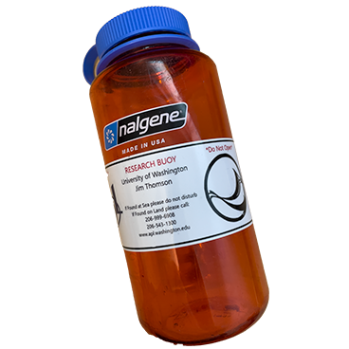
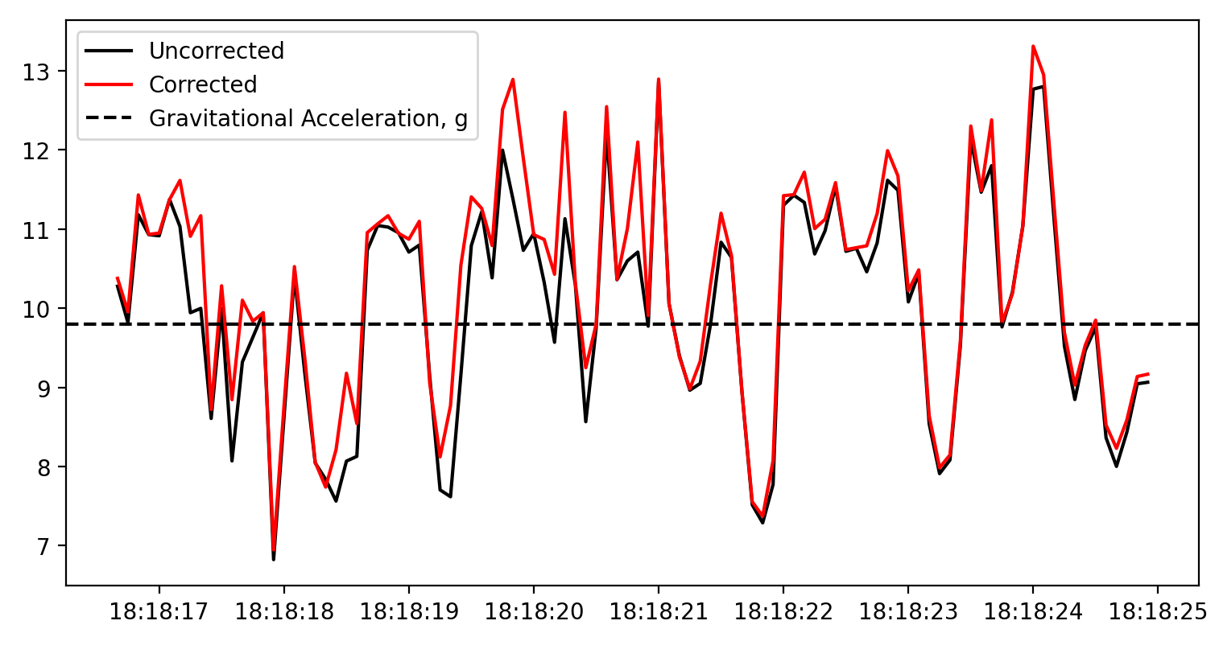
Figure 6 – Processing of Raw Data
(a)
AHRS Estimation and Band-Pass Filtered
g
g
Uncorrected Down
(relative to the buoy)
Corrected Down
(relative to the buoy)
(b)
Vertical Acceleration [m s⁻²]
Time [UTC]

Slide 9
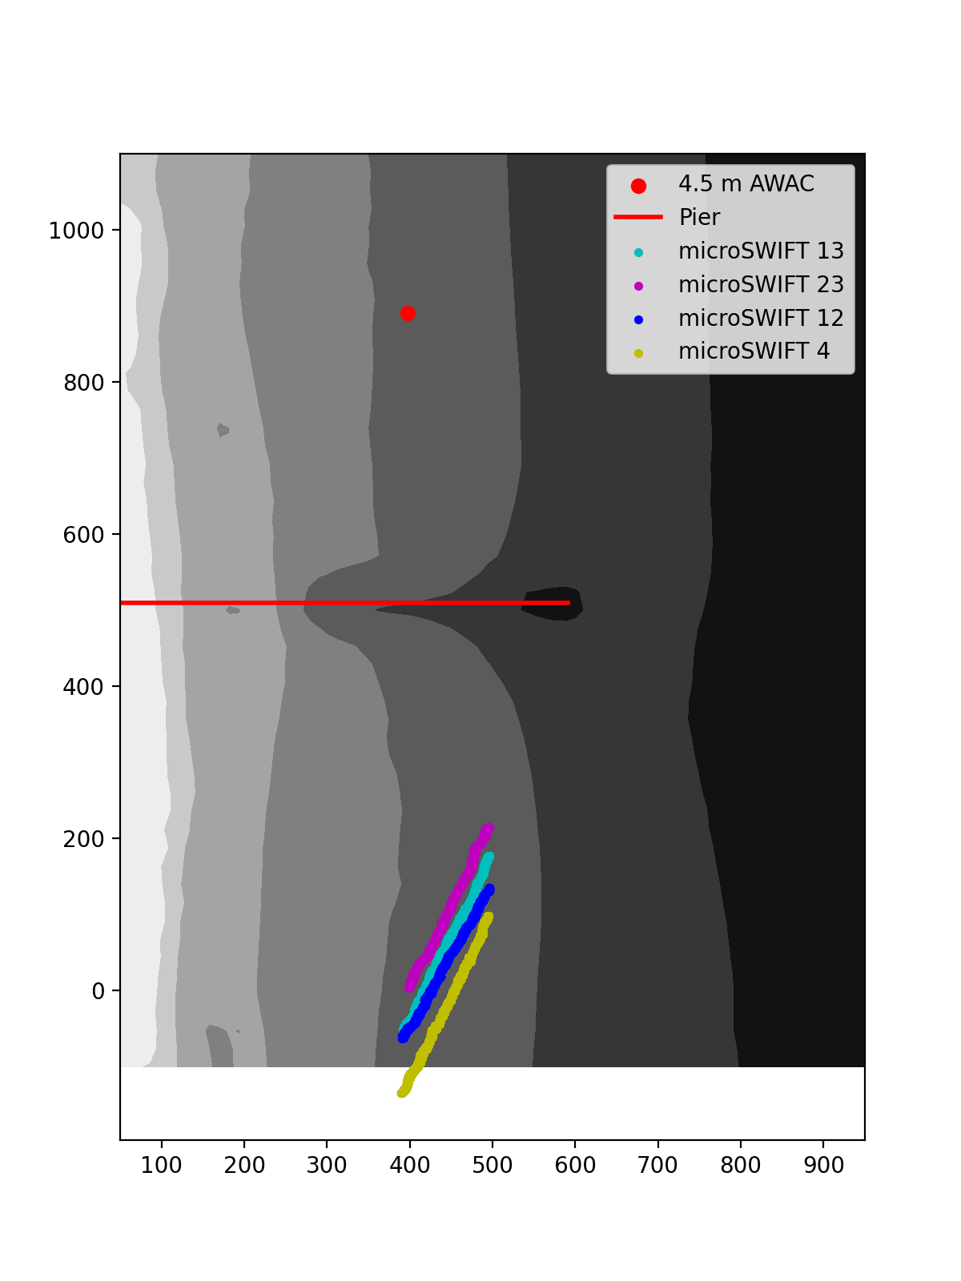
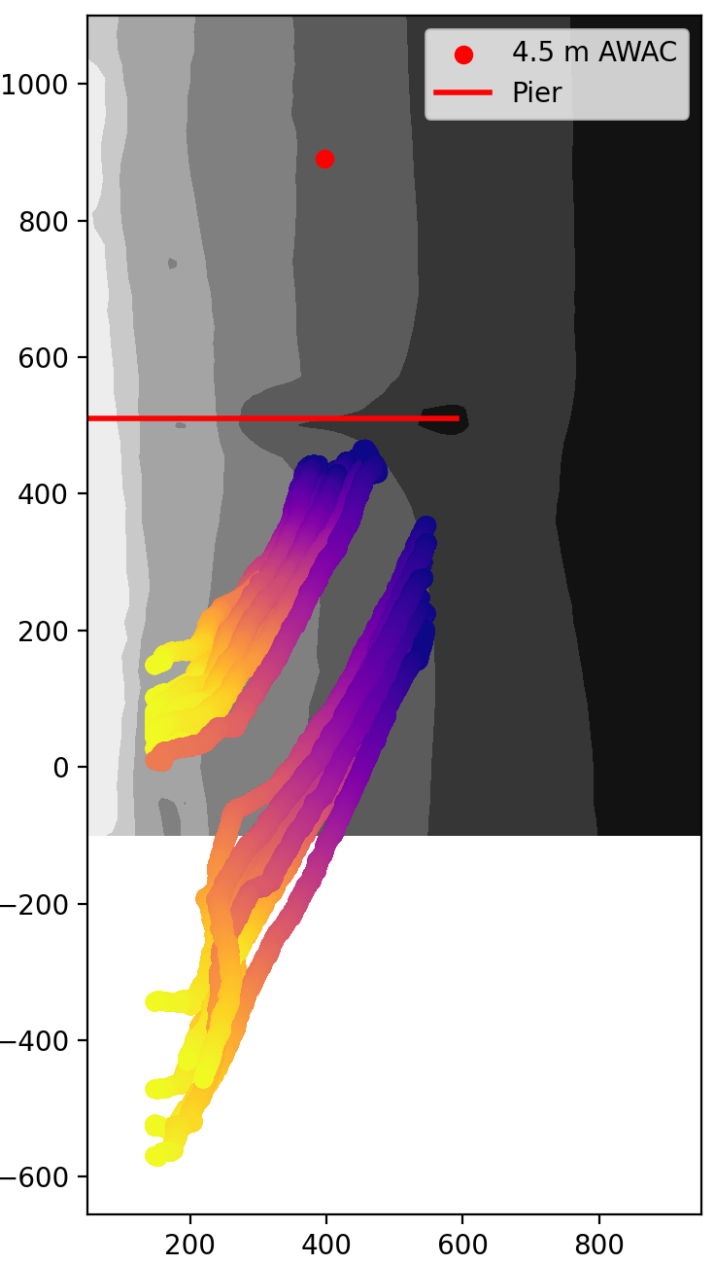
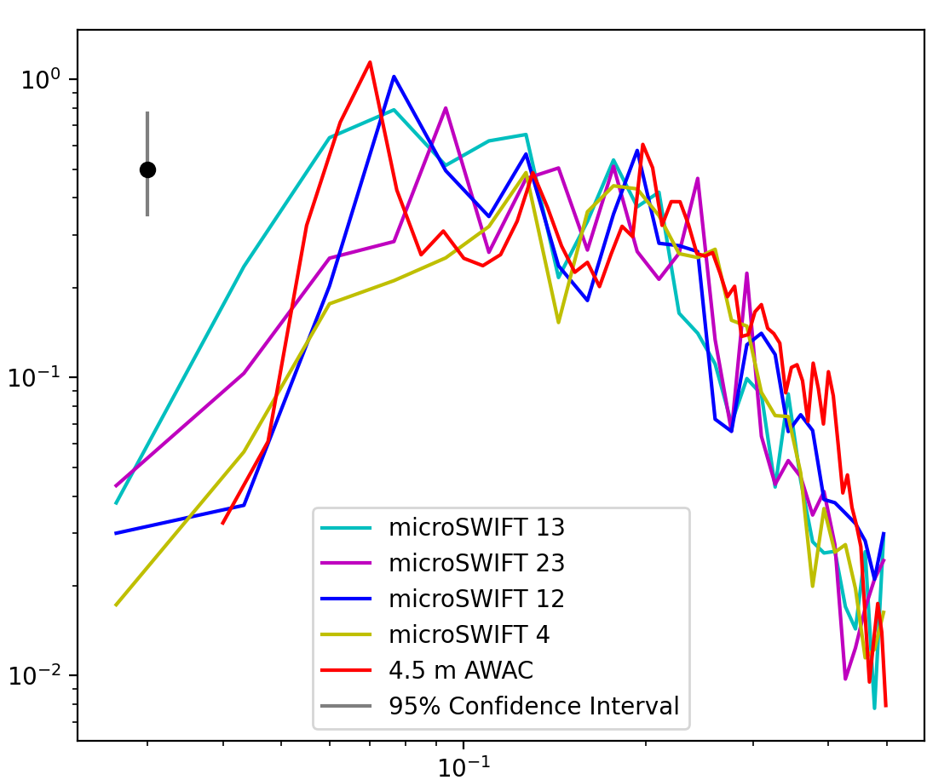
Figure 7 – microSWIFT spectral validation
Time [UTC]
2021-10-08 17:04
2021-10-08 17:41
(a)
(b)
-4 meters
-8 meters
-6 meters
-4 meters
-6 meters
-8 meters
Along Shore Distance [m]
Along Shore Distance [m]
Cross Shore Distance [m]
Cross Shore Distance [m]
(c)
Energy Density [m² Hz⁻¹]
Frequency [Hz]

Slide 10
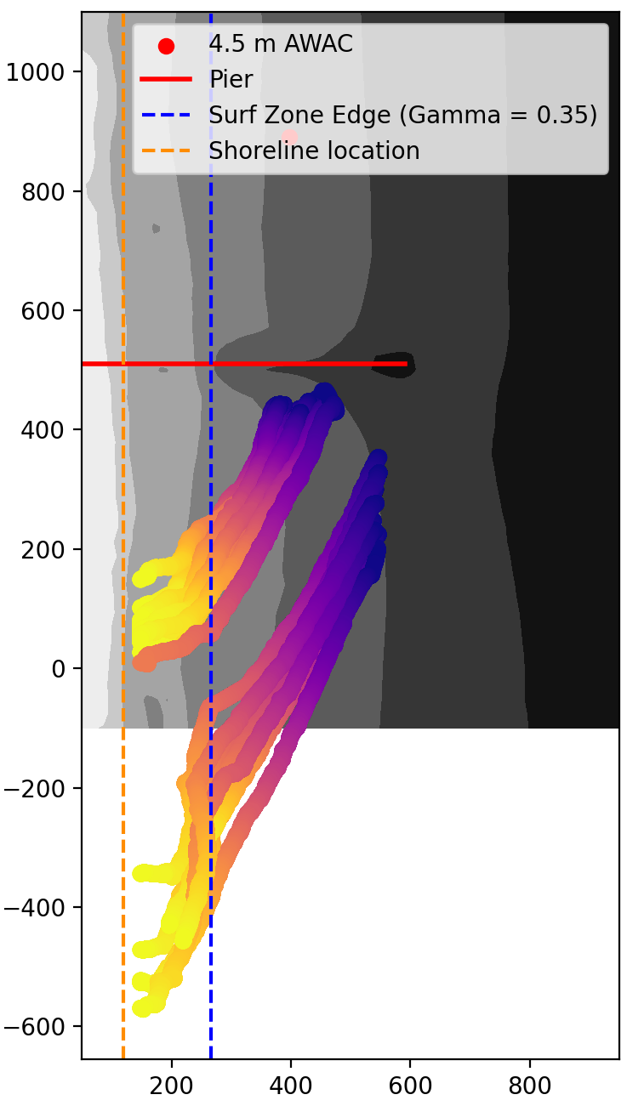
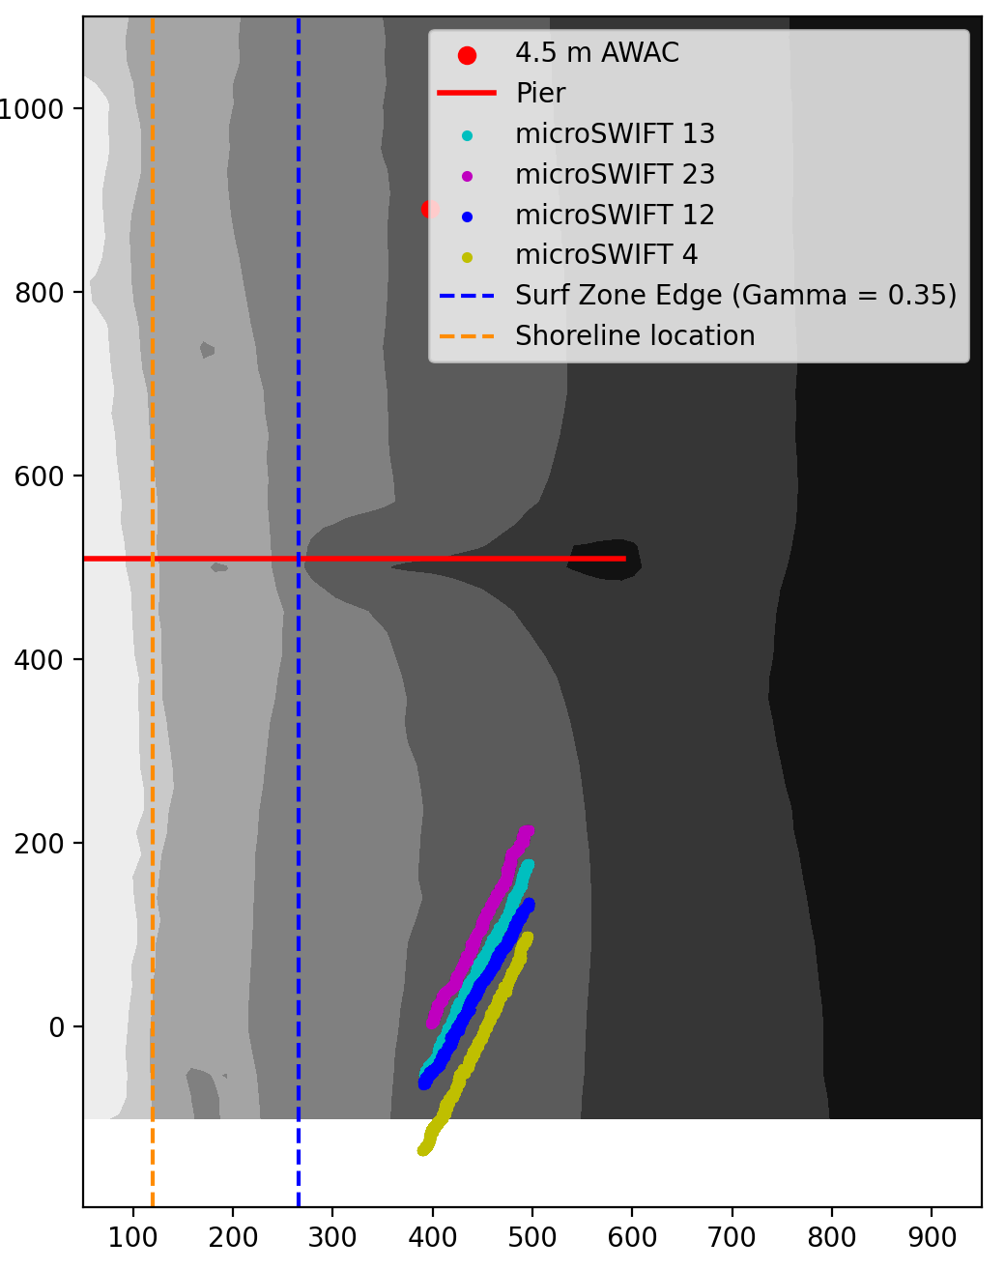
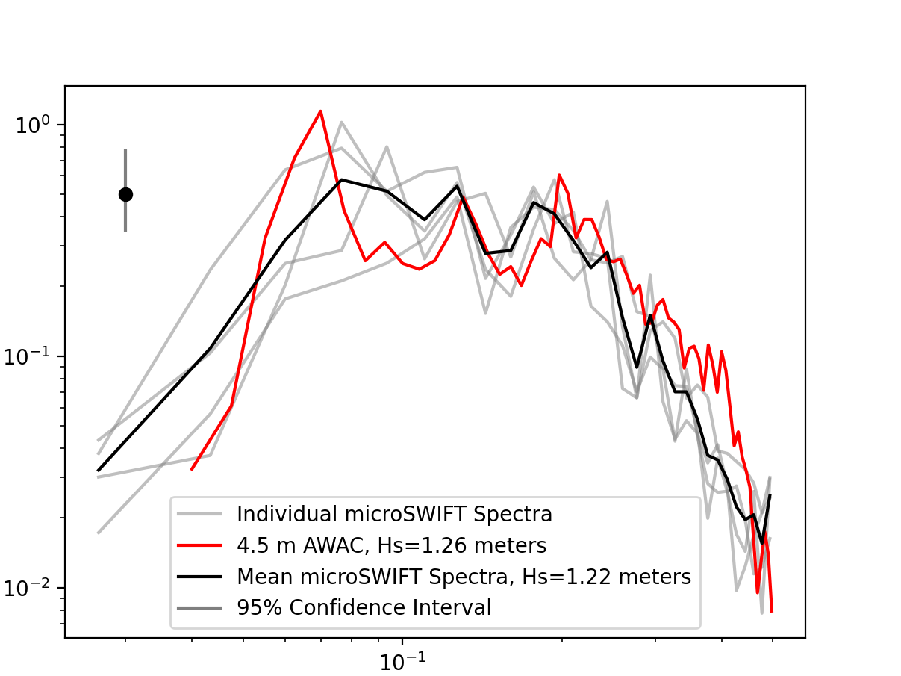
Figure 7 edited – microSWIFT spectral validation
Time [UTC]
2021-10-08 17:04
2021-10-08 17:41
(b)
(a)
-8 meters
-4 meters
-6 meters
-4 meters
-6 meters
-8 meters
-4 meters
-6 meters
-8 meters
Along Shore Distance [m]
Along Shore Distance [m]
-4 meters
-6 meters
-8 meters
Cross Shore Distance [m]
Cross Shore Distance [m]
(c)
(c)
Energy Density [m² Hz⁻¹]
Frequency [Hz]

Slide 11
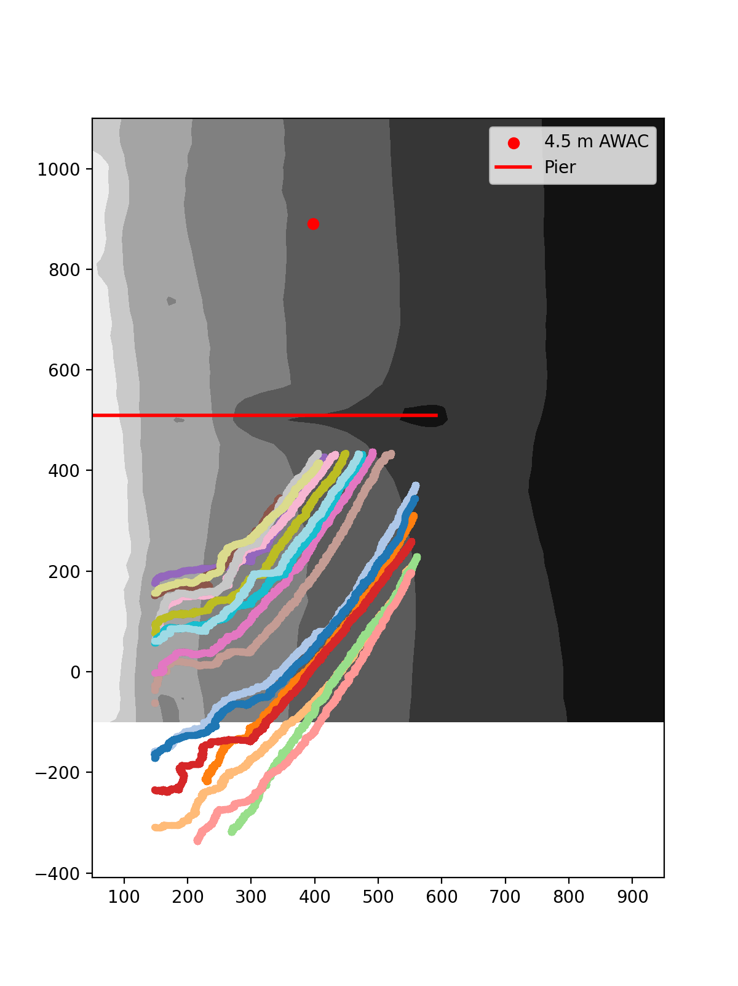
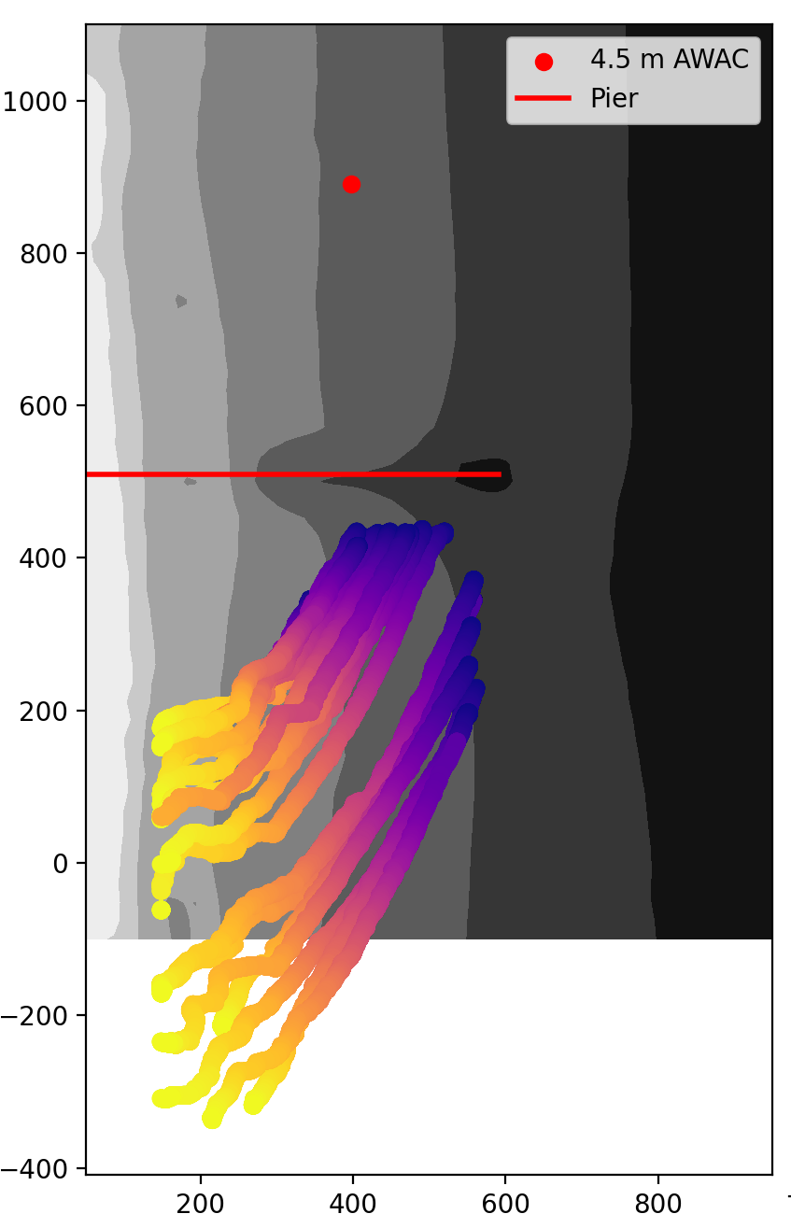
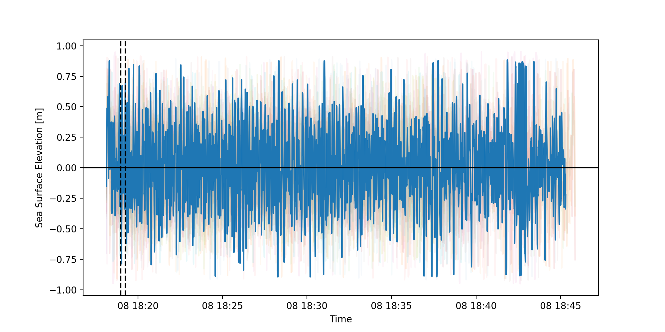
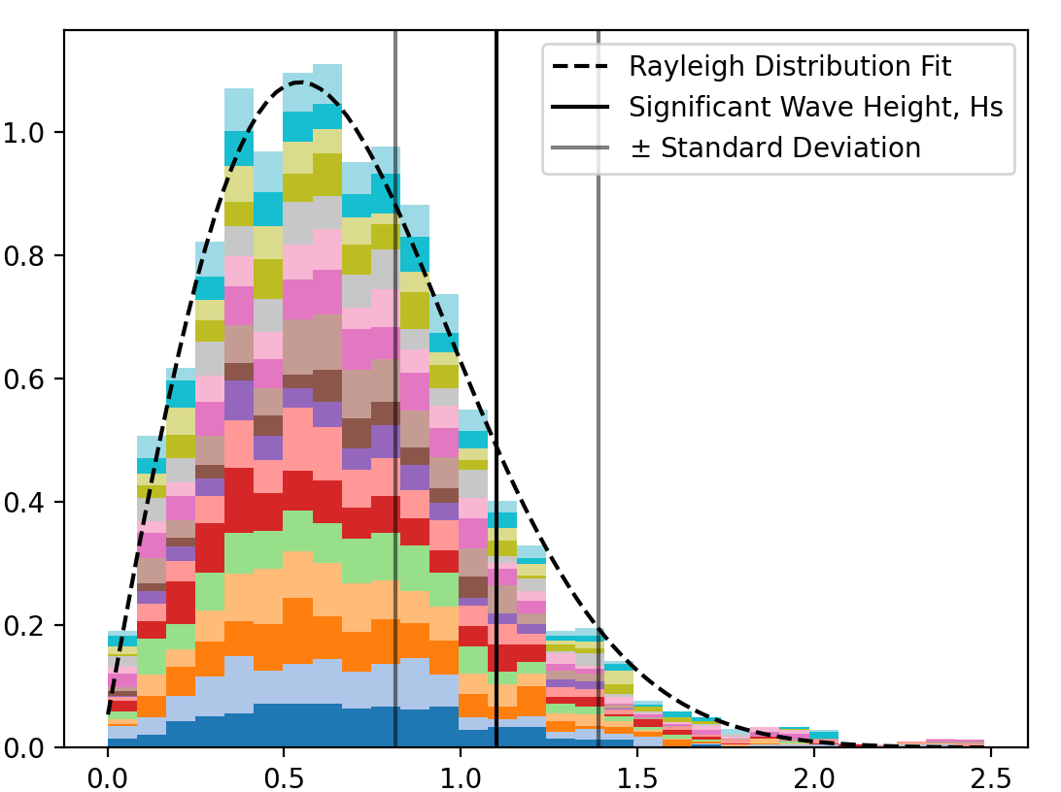
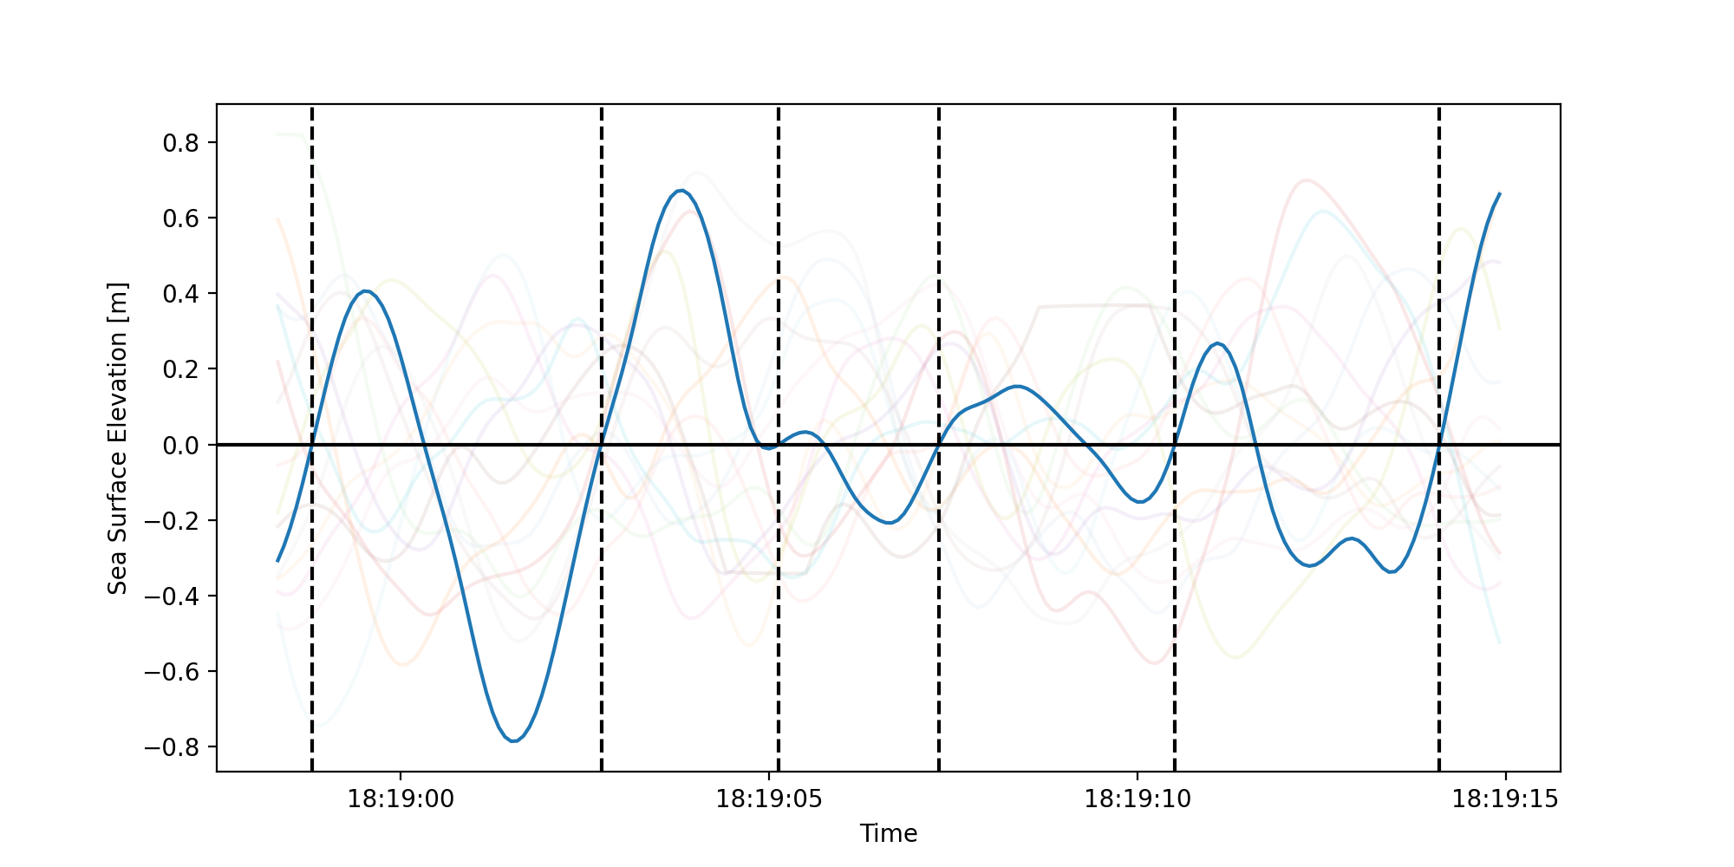
Figure 8 - Mission Processing Steps
Time [UTC]
2021-10-08 18:18
2021-10-08 18:45
(a)
(b)
-4 meters
-8 meters
-4 meters
-6 meters
-8 meters
-6 meters
Along Shore Distance [m]
Along Shore Distance [m]
Cross Shore Distance [m]
Cross Shore Distance [m]
(c)
(e)
Sea Surface Elevation [m]
Time [UTC]
Probability Density
(d)
H
Sea Surface Elevation [m]
Wave Height, H [m]
Time [UTC]

Slide 12
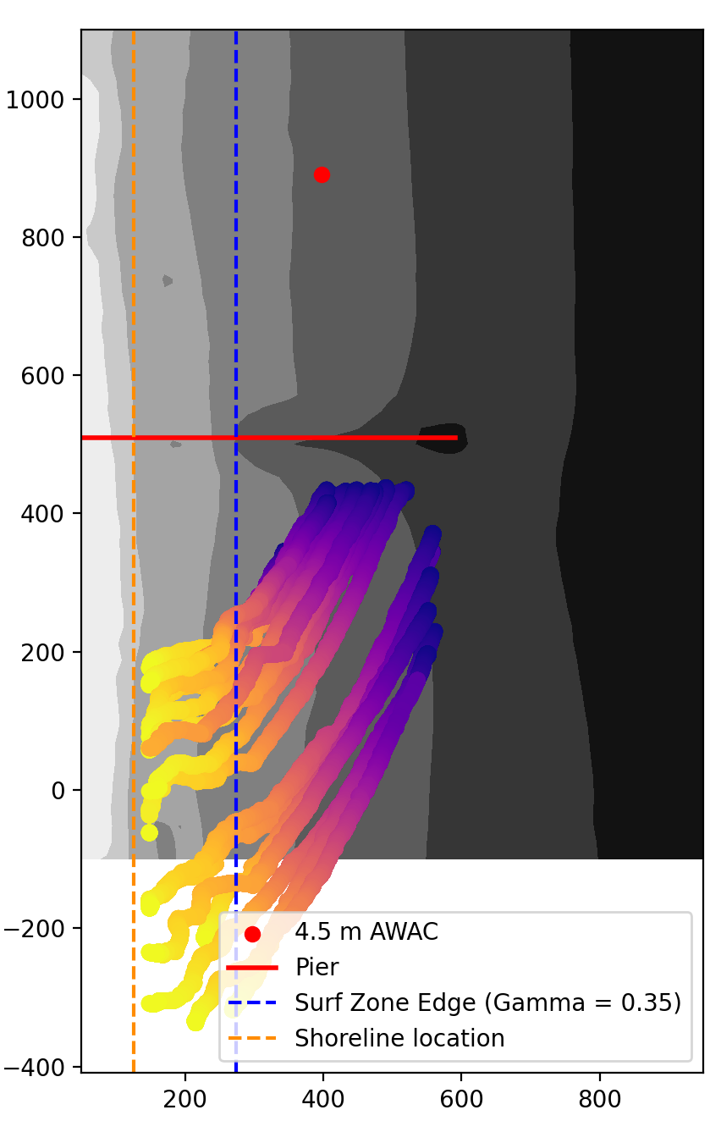
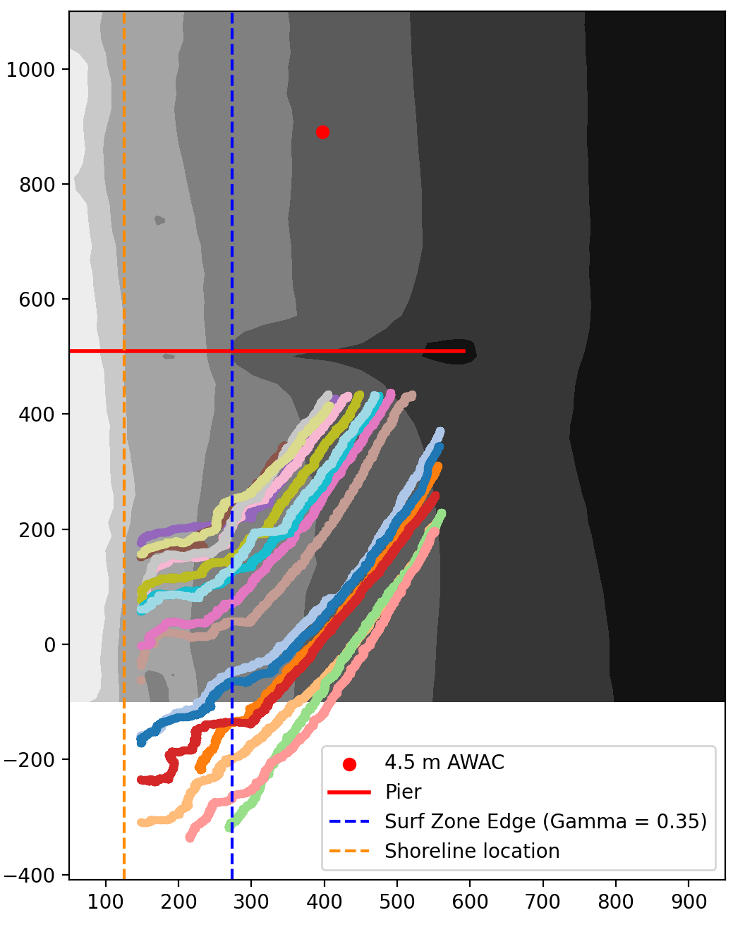
Figure 8 edited - Mission Processing Steps
Time [UTC]
2021-10-08 18:18
2021-10-08 18:45
(a)
(b)
-4 meters
-8 meters
-8 meters
-4 meters
-6 meters
-8 meters
-4 meters
-6 meters
-6 meters
-6 meters
-8 meters
-4 meters
Along Shore Distance [m]
Along Shore Distance [m]
Cross Shore Distance [m]
Cross Shore Distance [m]
(c)
(e)
Sea Surface Elevation [m]
Time [UTC]
Probability Density
(d)
H
Sea Surface Elevation [m]
Wave Height, H [m]
Time [UTC]

Slide 13
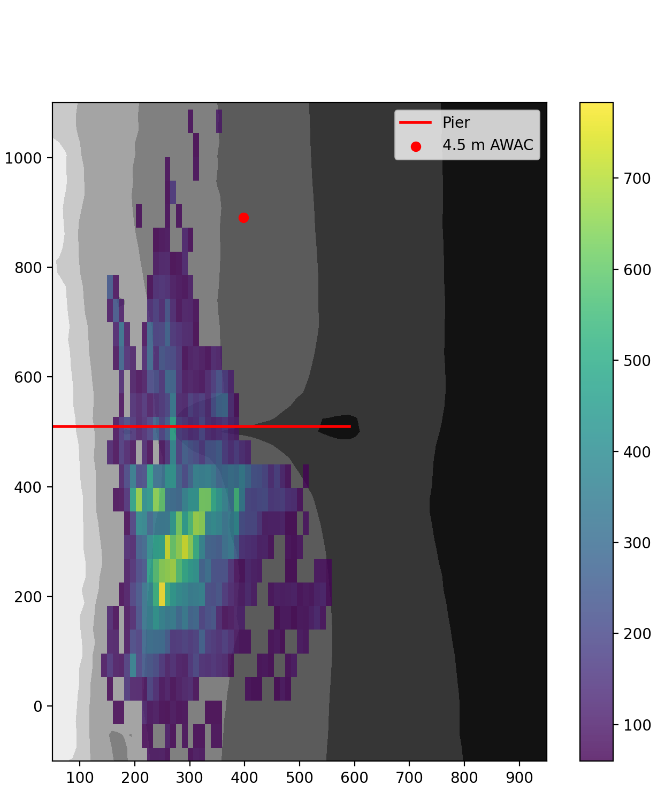
Figure 9 - Density of Waves Measured
-4 meters
-6 meters
-8 meters
Along Shore Distance [m]
Number of Wave Realizations
Cross Shore Distance [m]
Notes:
Move to after the figures on the next page

Slide 14
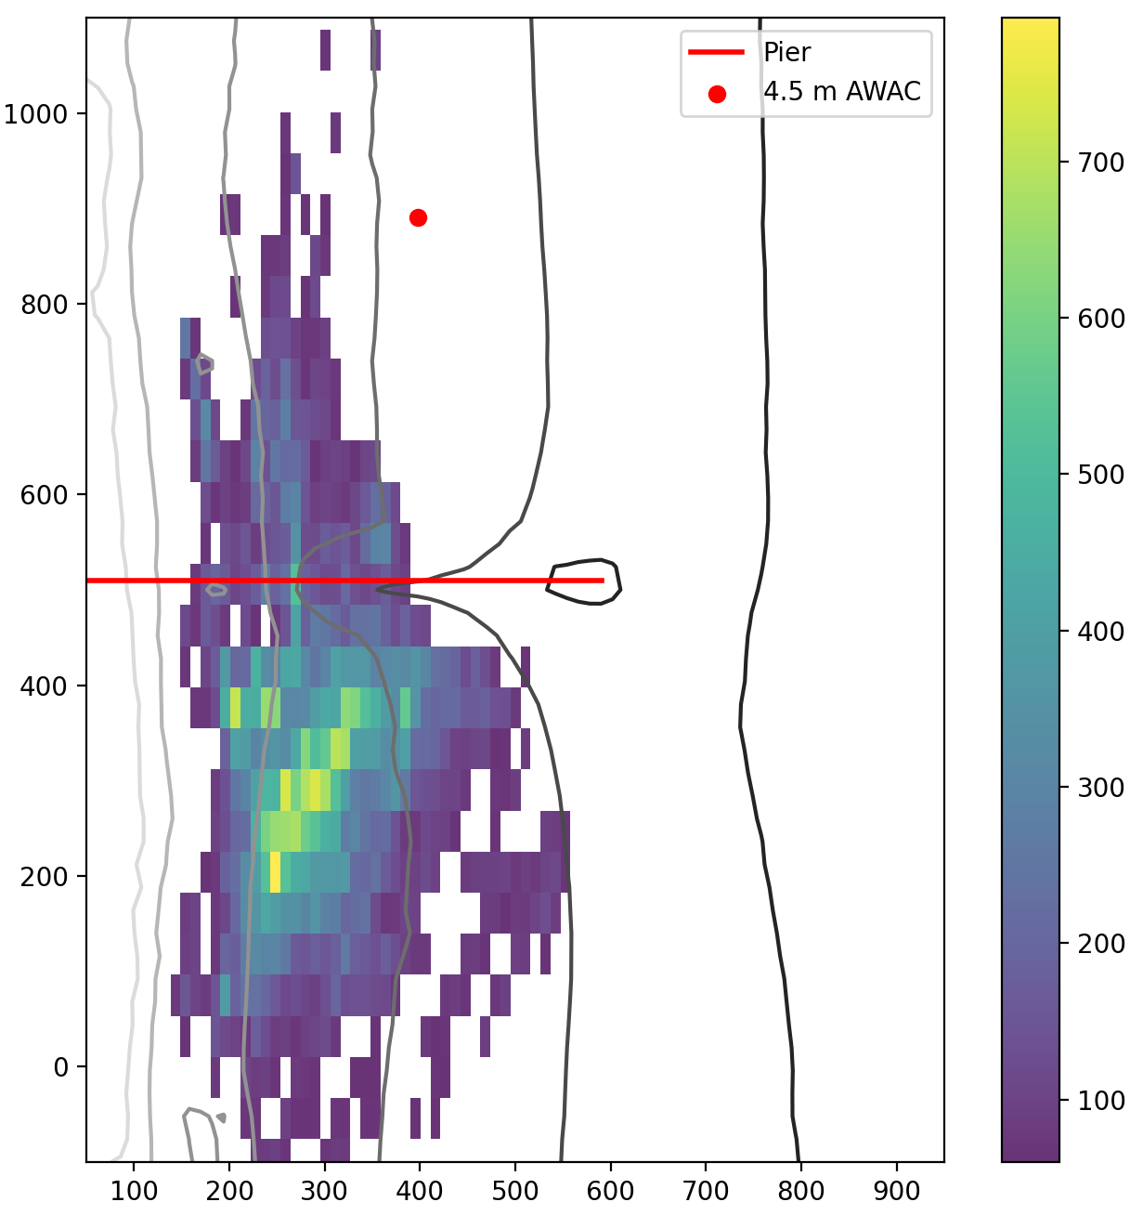
Figure 9 edited - Density of Waves Measured
-4 meters
-6 meters
-8 meters
Along Shore Distance [m]
Number of Wave Realizations
Cross Shore Distance [m]
Notes:
Move to after the figures on the next page

Slide 15
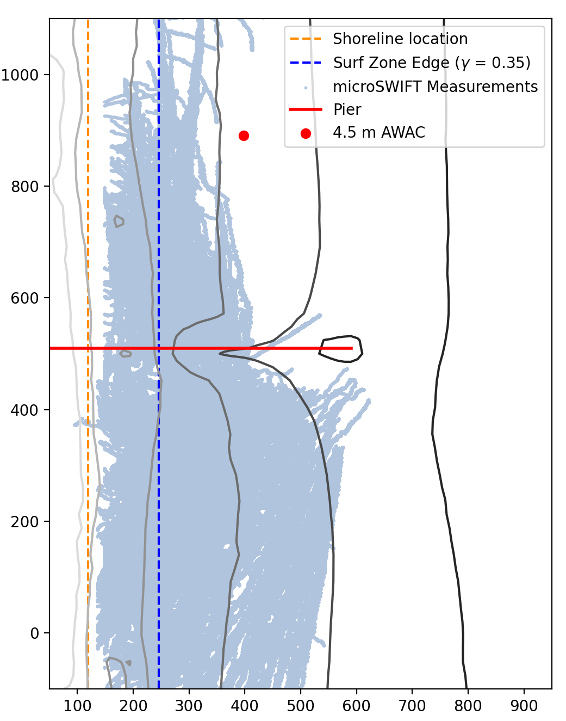
Figure 9 edited - Density of Waves Measured
-4 meters
-6 meters
-8 meters
Along Shore Distance [m]
Cross Shore Distance [m]
Notes:
Move to after the figures on the next page

Slide 16
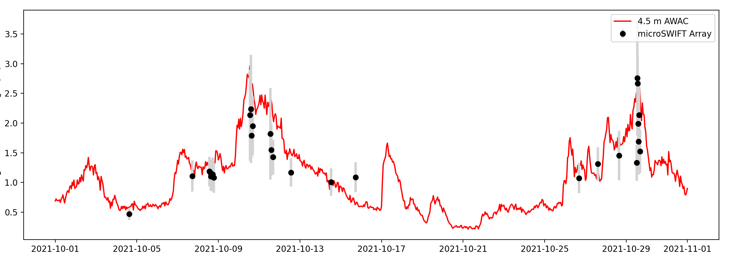
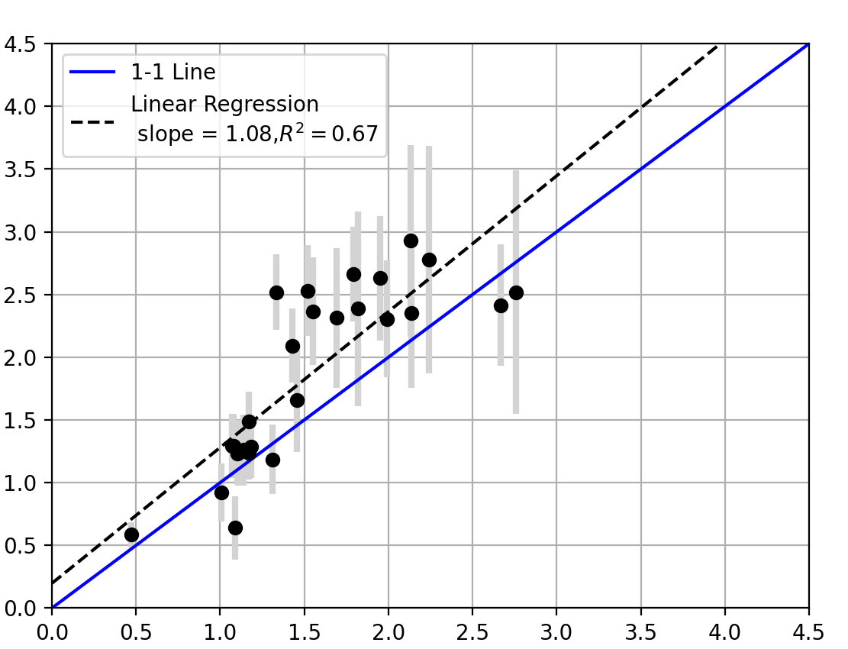
Figure 10 - Comparison of only waves 4-5 meters (Updated with higher despiking threshold)
(a)
(a)
Significant Wave Height [m]
Time [UTC]
(b)
4.5 m AWAC Significant Wave Height [m]
microSWIFT Array Significant Wave Height [m]
Notes:
Make it clear you are talking about bathymetry with the 4-5 meters title. I assumed wave height.

Slide 17
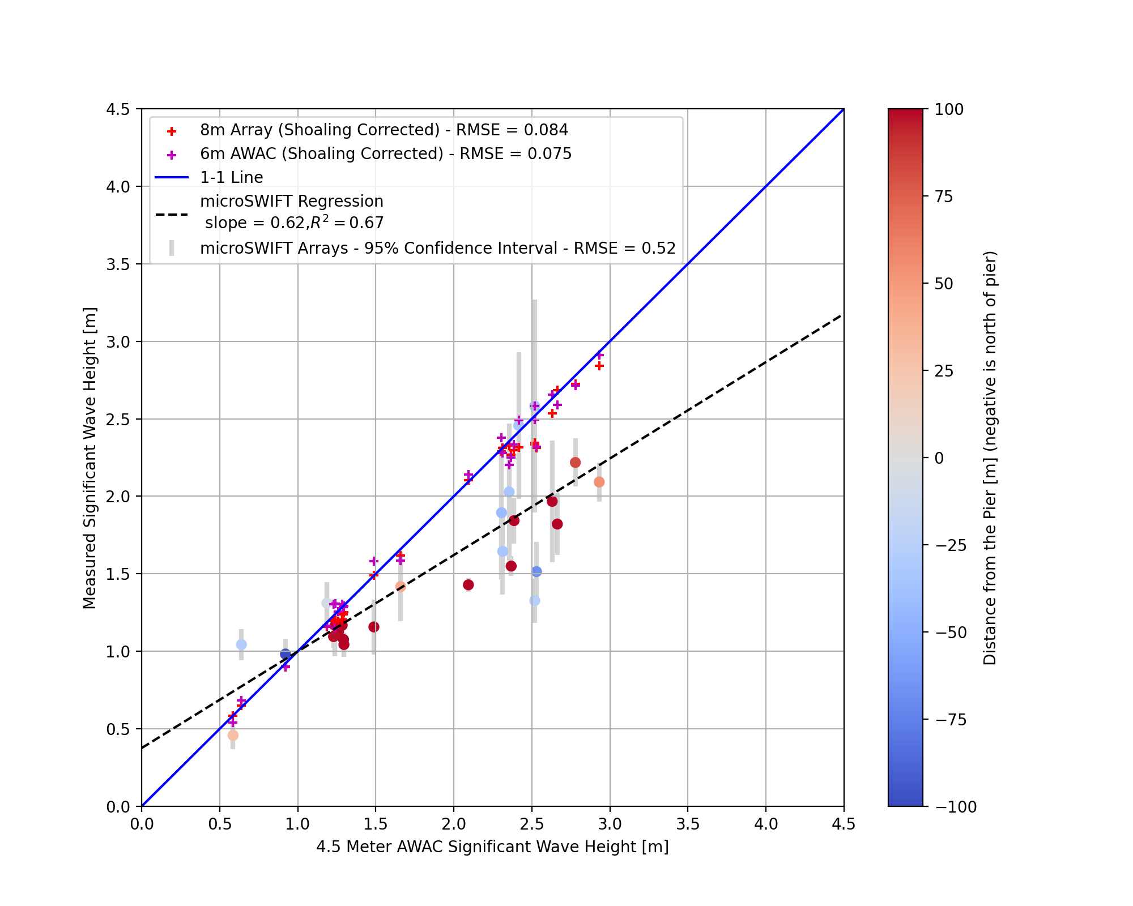
Figure 10 edited - Comparison of only waves 4-5 meters with shoaling corrected 8m array and 6 m awac along with showing direction from pier
Notes:
Make it clear you are talking about bathymetry with the 4-5 meters title. I assumed wave height.

Slide 18
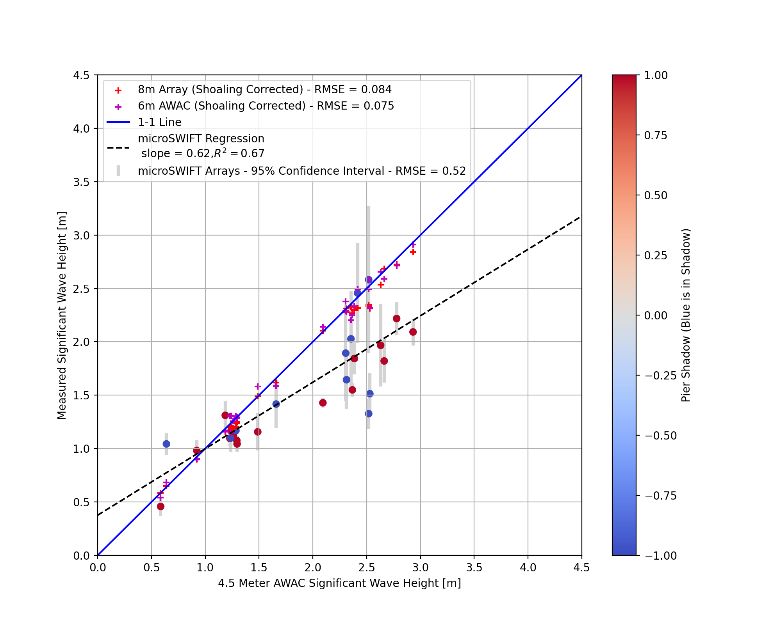
Figure 10 edited - Comparison of only waves 4-5 meters with shoaling corrected 8m array and 6 m awac along with showing direction from pier
Notes:
Make it clear you are talking about bathymetry with the 4-5 meters title. I assumed wave height.

Slide 19
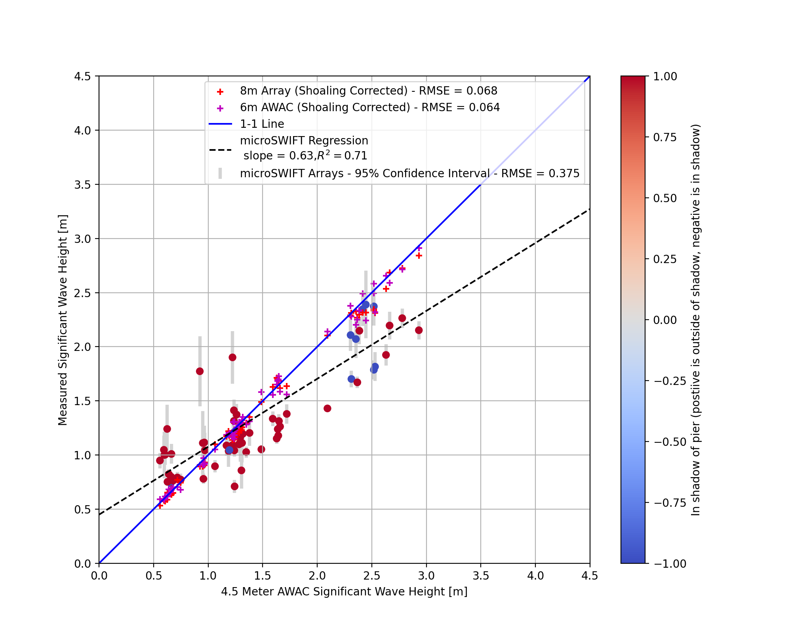
Figure 10 edited - Comparison of all waves outside of surfzone with shoaling corrected 8m array and 6 m awac along with showing direction from pier
Notes:
Make it clear you are talking about bathymetry with the 4-5 meters title. I assumed wave height.

Slide 20
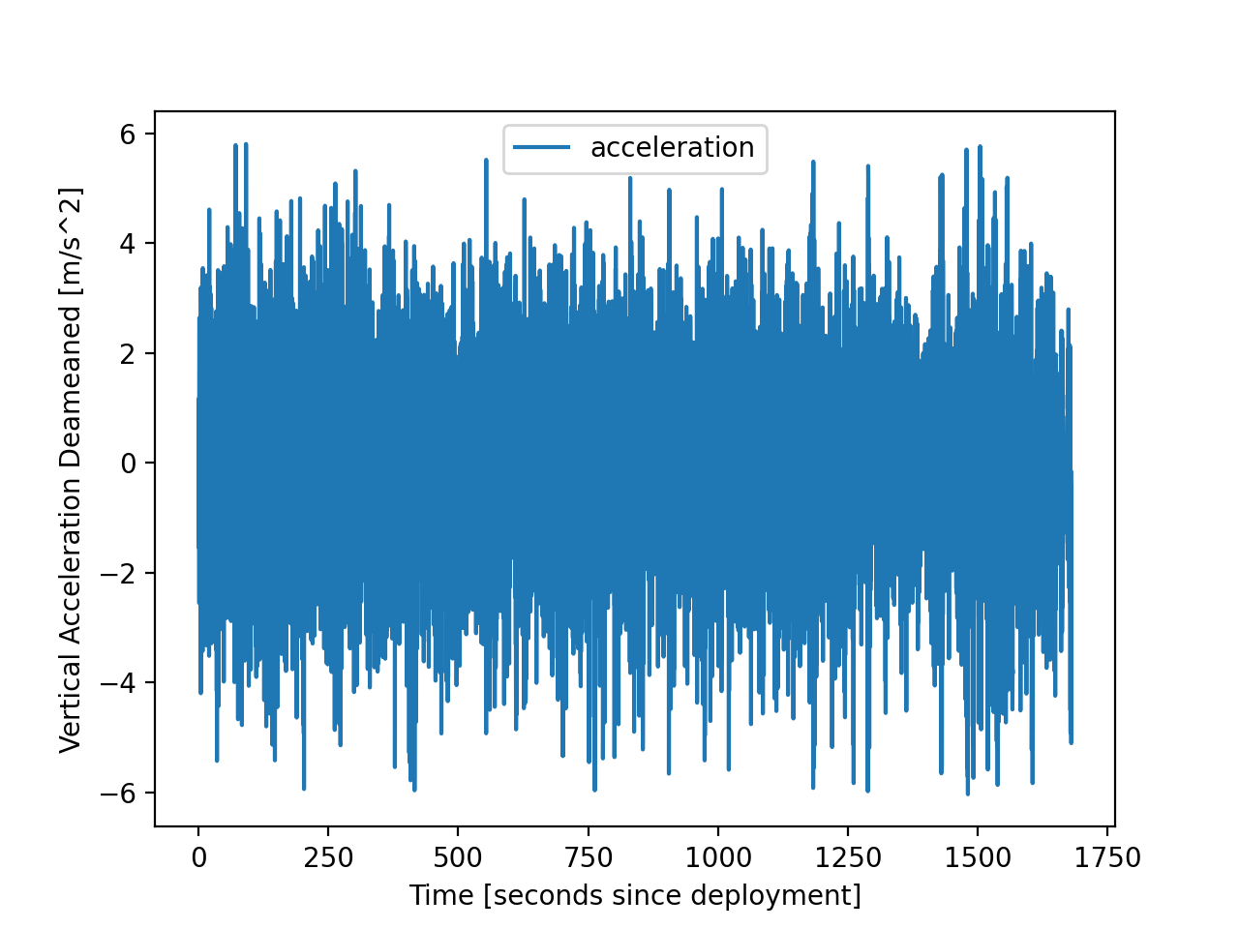
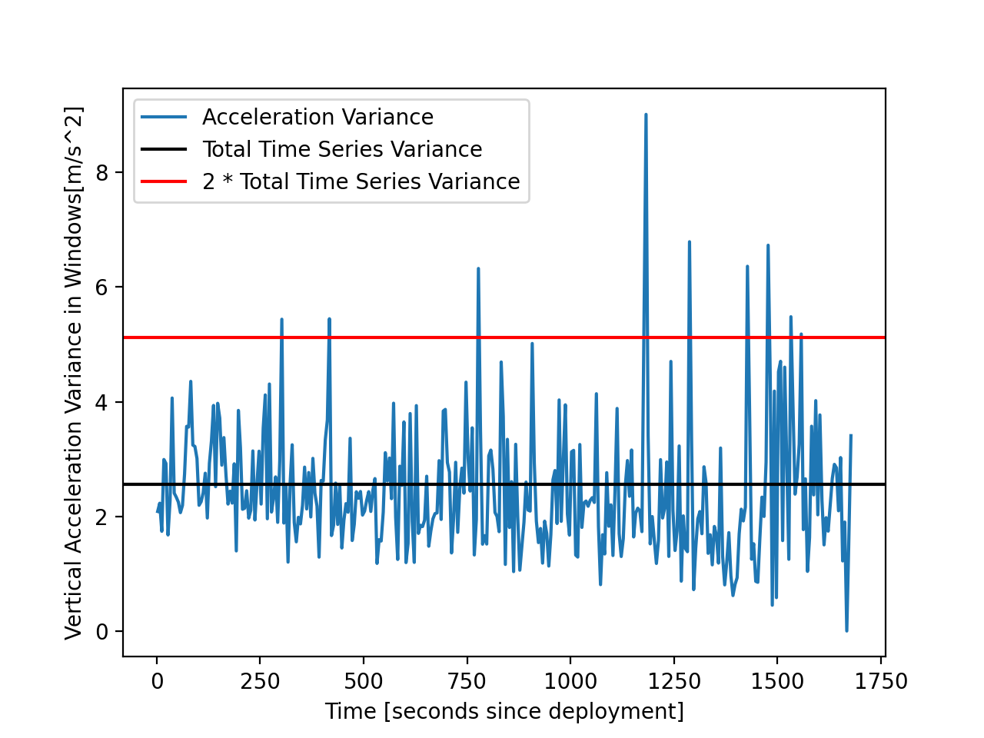
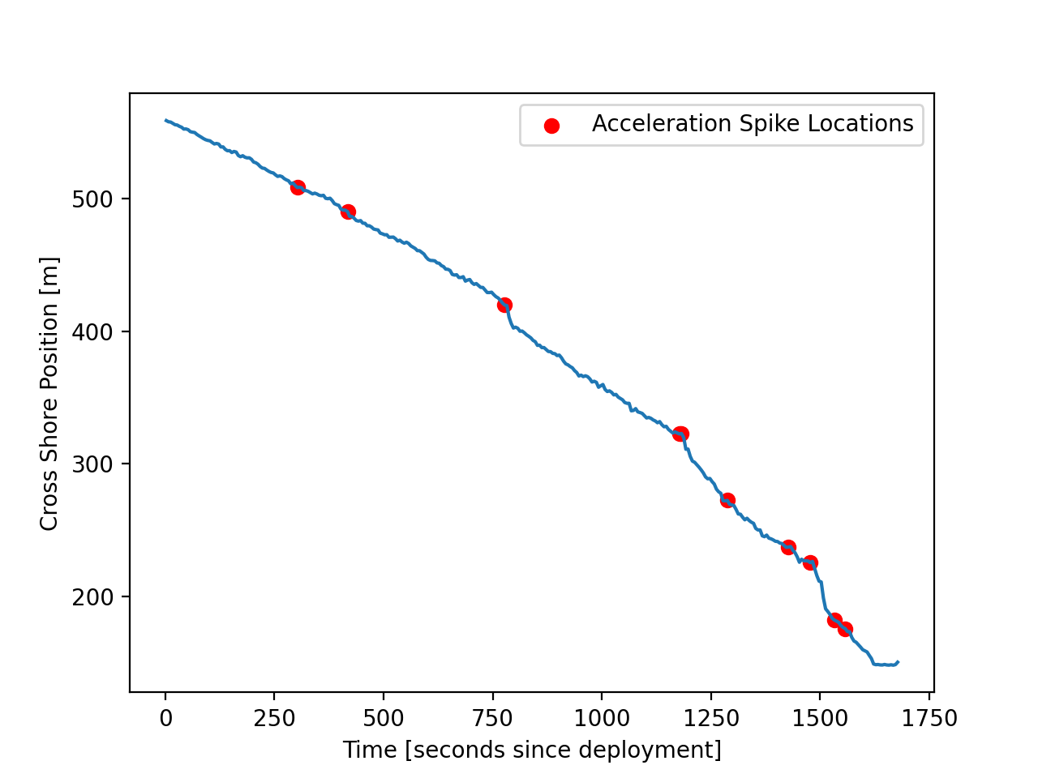
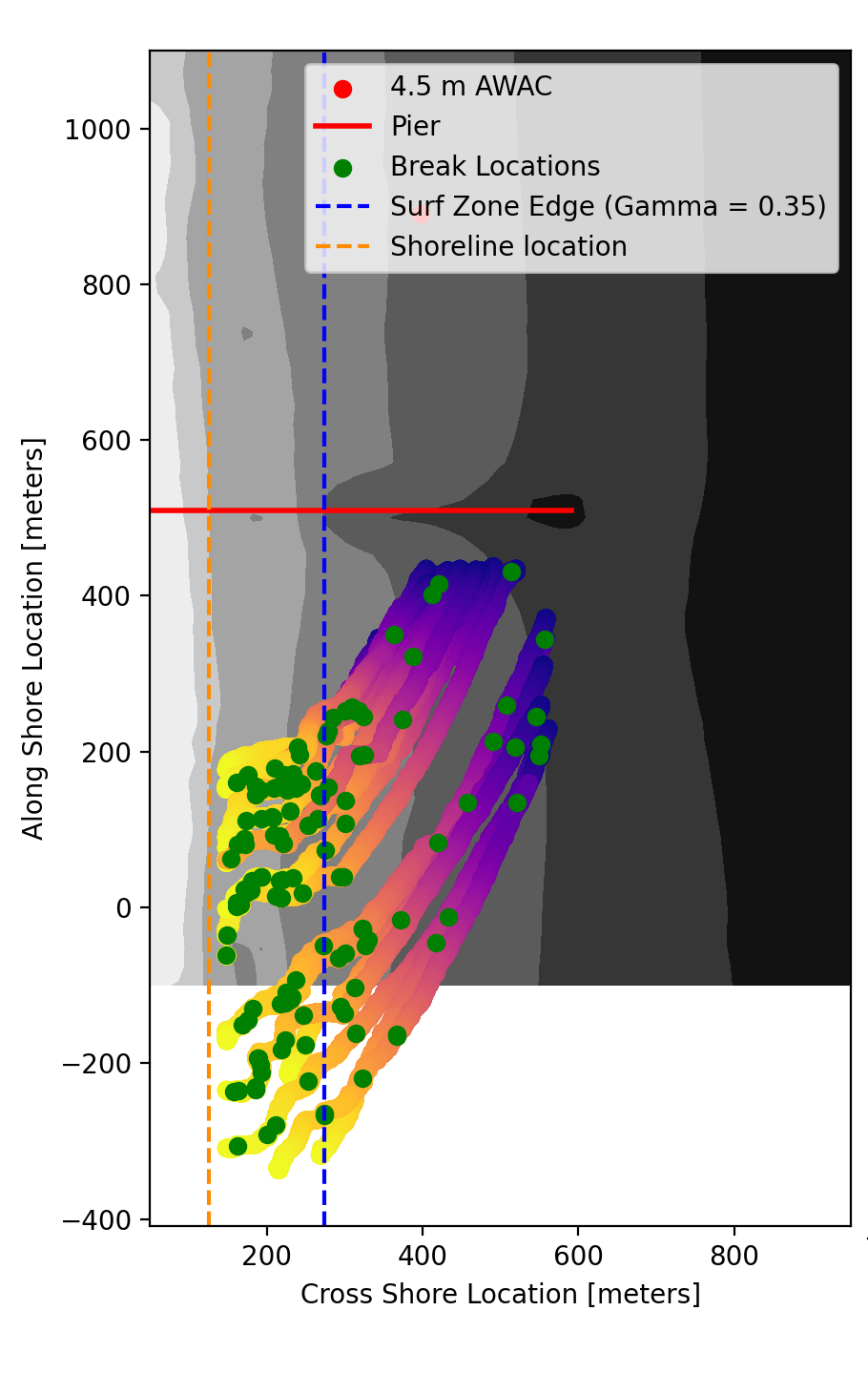
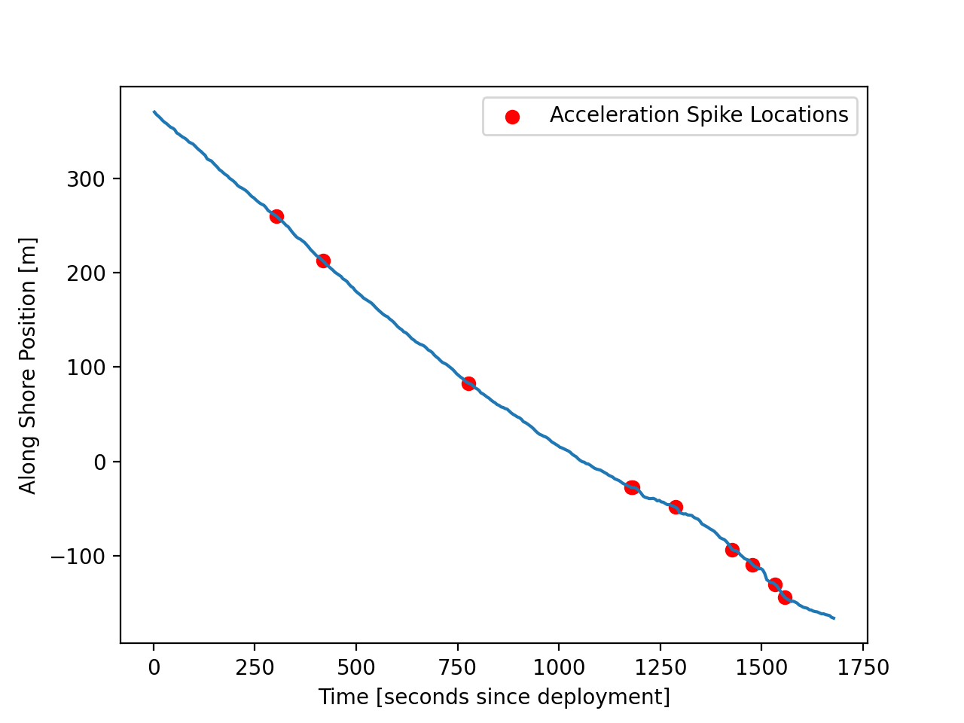
Figure 11 – Breaking Identification in mission 19
Time [UTC]
2021-10-08 18:18
2021-10-08 18:45
(a)
-4 meters
-8 meters
-8 meters
-4 meters
-6 meters
-8 meters
-4 meters
-6 meters
-6 meters
-6 meters
-8 meters
-4 meters
Along Shore Distance [m]
Cross Shore Distance [m]
Notes:
Make it clear you are talking about bathymetry with the 4-5 meters title. I assumed wave height.

Slide 21
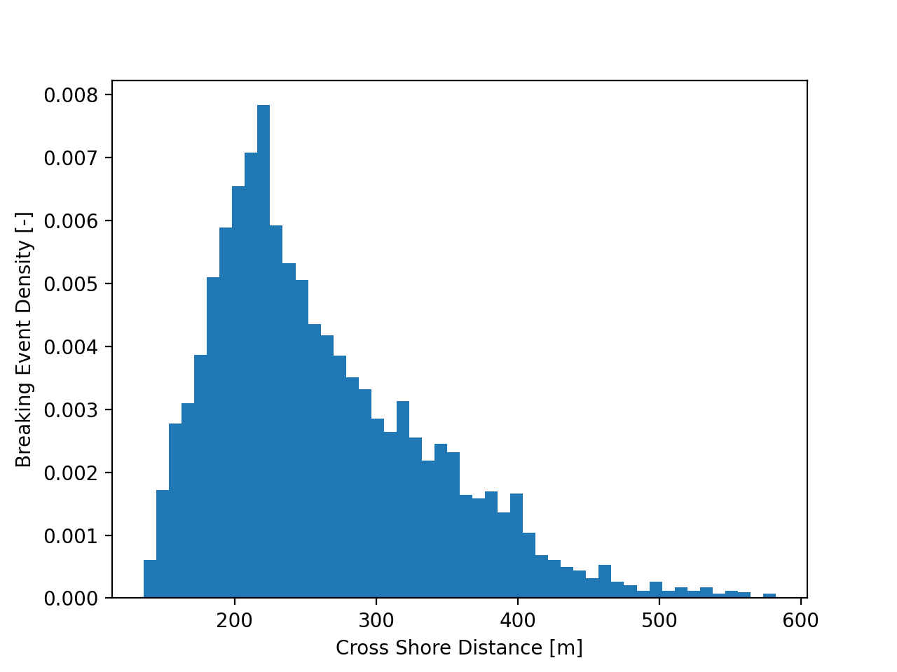
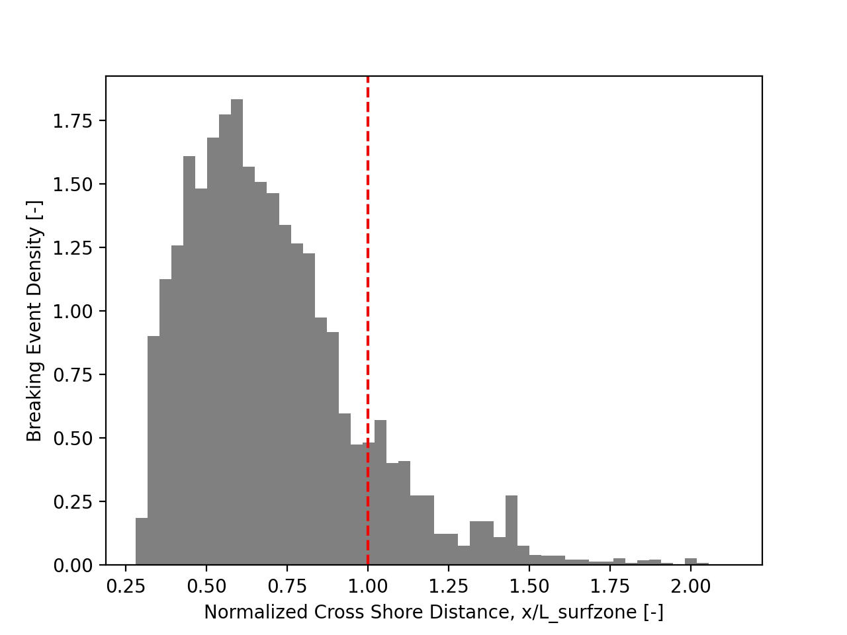
Figure 12 – Breaking Identification across all missions
Notes:
Make it clear you are talking about bathymetry with the 4-5 meters title. I assumed wave height.

Slide 22
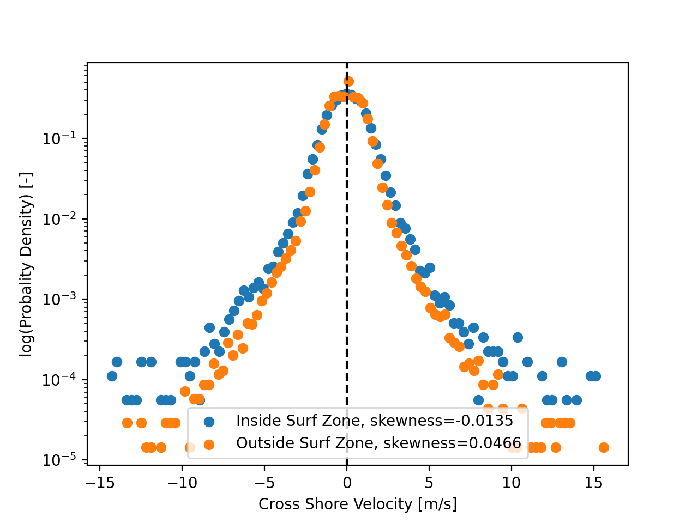
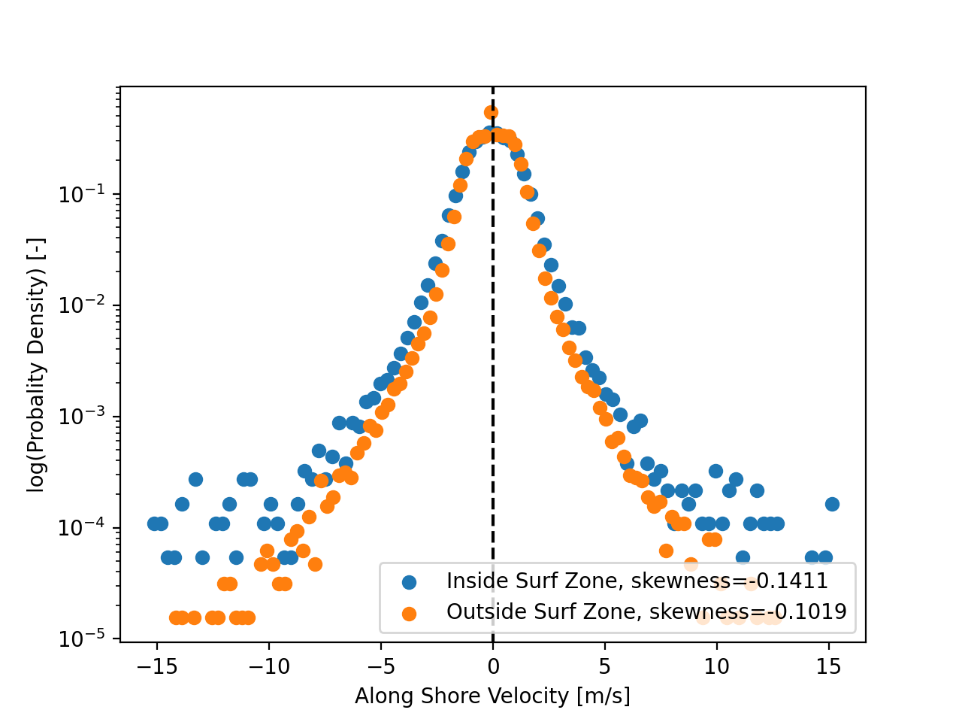
Figure 13 – Velocity Distributions Mission 19
Notes:
Make it clear you are talking about bathymetry with the 4-5 meters title. I assumed wave height.

Slide 23
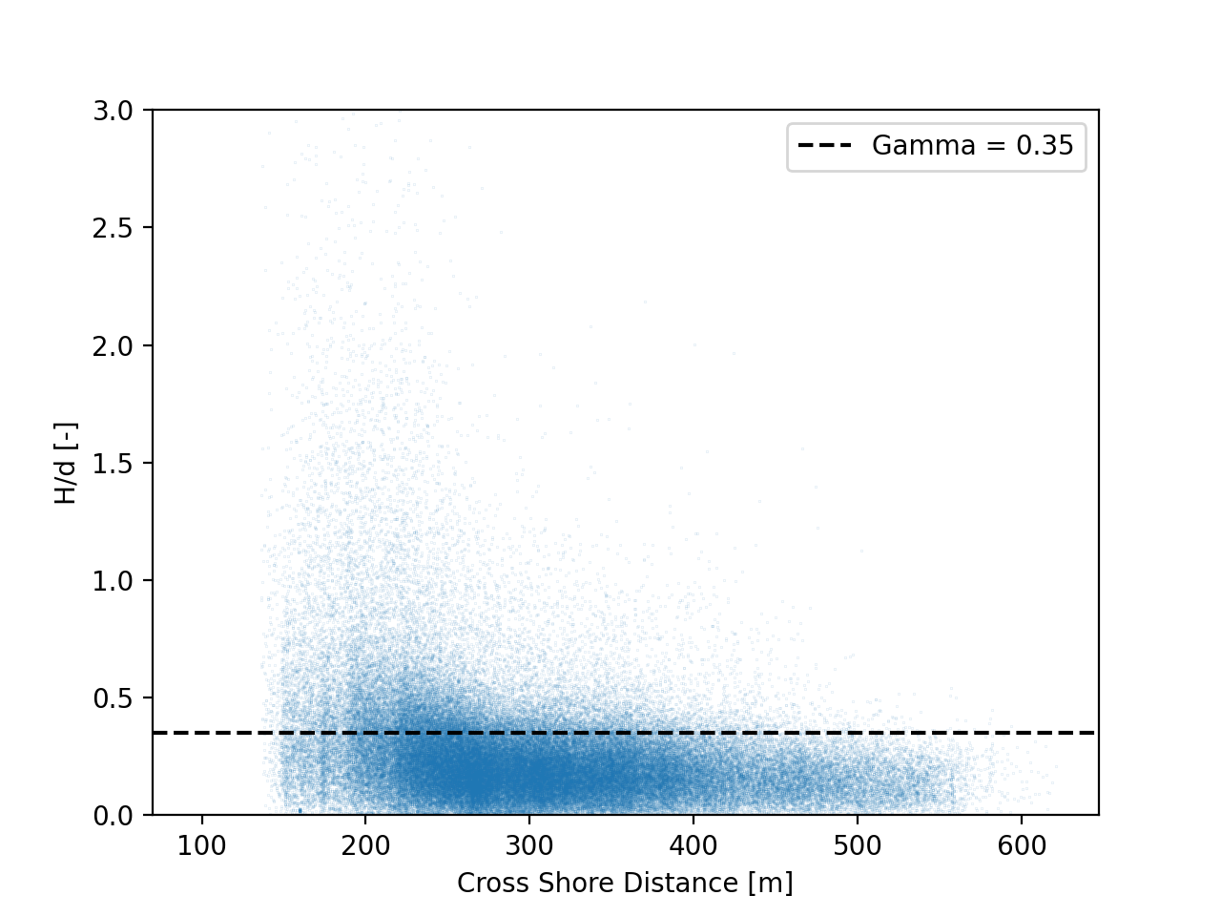
Figure 11 – Cross Shore Profiles of U/c and H/d
Notes:
Make it clear you are talking about bathymetry with the 4-5 meters title. I assumed wave height.

